Slide 1
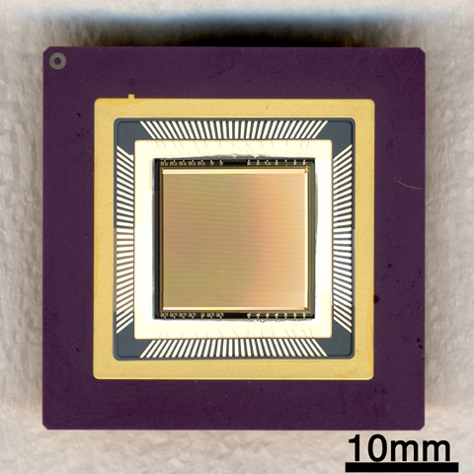
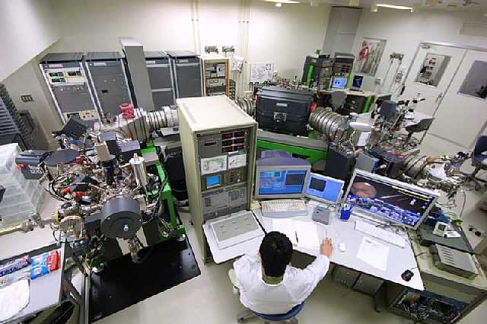
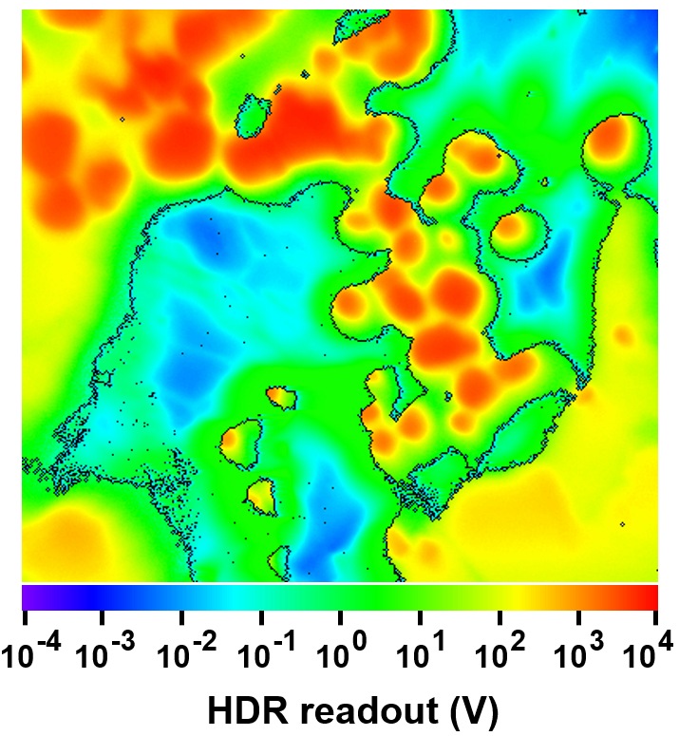
High dynamic range ion imaging using individual pixel reset of SCAPS detector
ALC’22 Imaging Microscope 19a-3-3
Naoya Sakamoto (Hokkaido U.)
²⁴Mg⁺
10⁸
ions / pixel
SCAPS ion detector
Stigmatic D-SIMS
Notes:
I’m Naoya Sakamoto from Hokkaido University.
We developed a high dynamic range ion imaging system
(10^8を指す)
using a two-dimensional ion detector
(SCAPSを指す)
and a stigmatic SIMS.
(SIMSを指す)
At first, I will explain what kind of imaging we need.

Slide 2
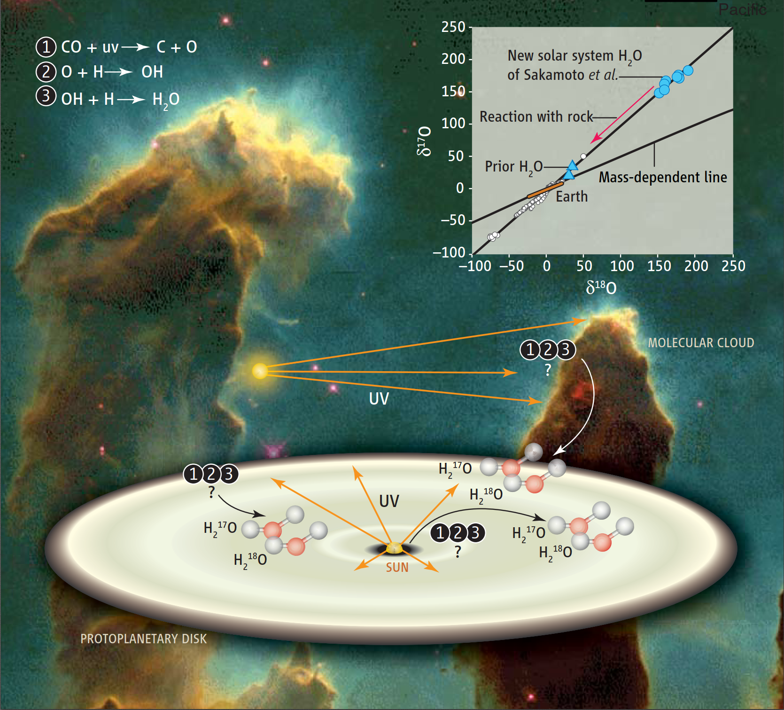
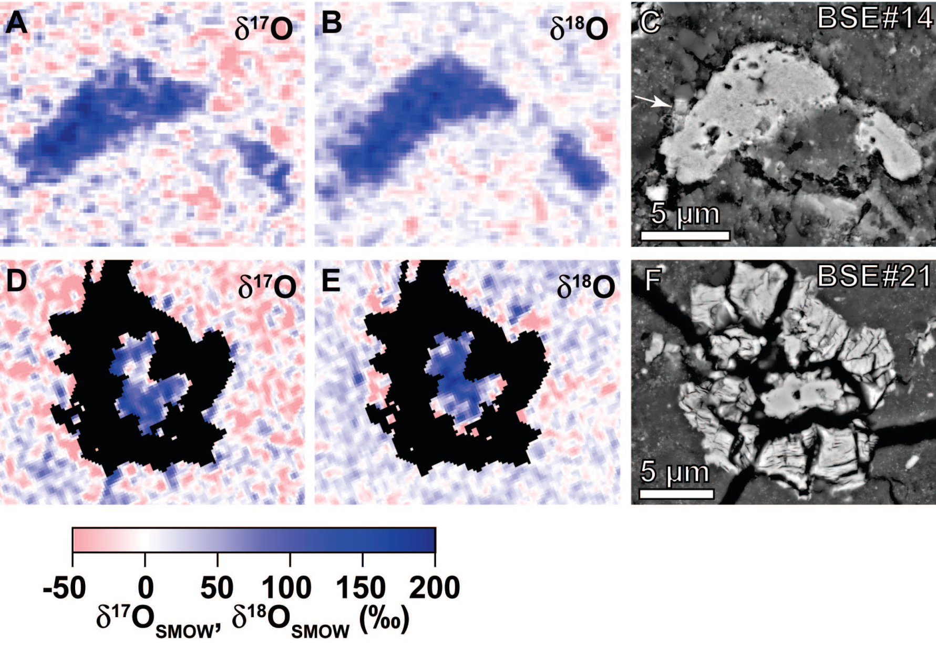
Primordial Water
in the Solar System
Heaviest oxygen isotopic composition
Cosmic Symplectite（Fe₃O₄＋FeS）
Sakamoto et al. 2007 Science
Fe/FeS + H₂O → Fe₃O₄
Notes:
Fifteen years ago, isotopically anomalous material was accidentally discovered from a meteorite.
These are SEM images and oxygen isotope ratio images.
Scale bars are 5 micron.
This material was found to be oxidized by primordial water in the solar system having a heavy oxygen isotopic composition.
This discovery was entirely coincidental, but open the door to understanding our solar system formation.

Slide 3
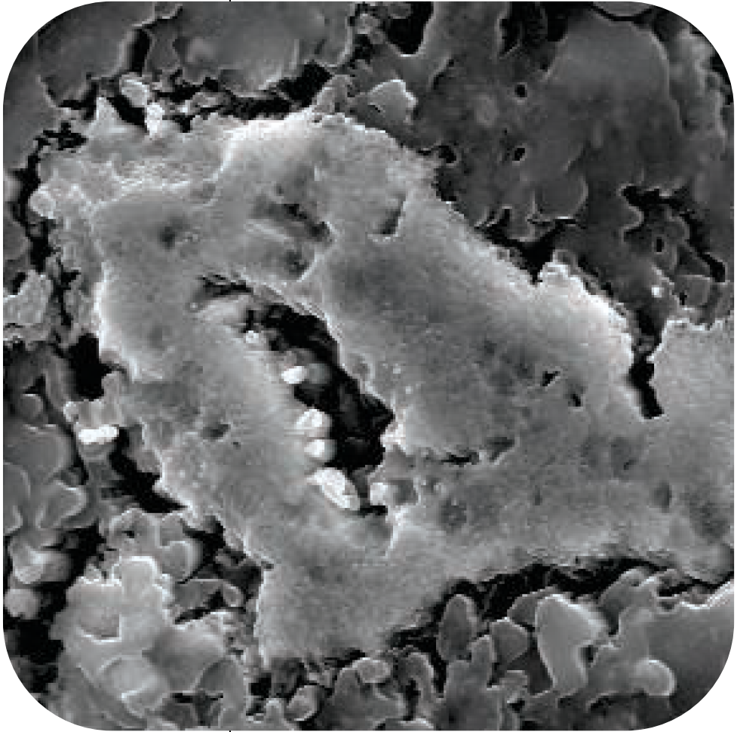
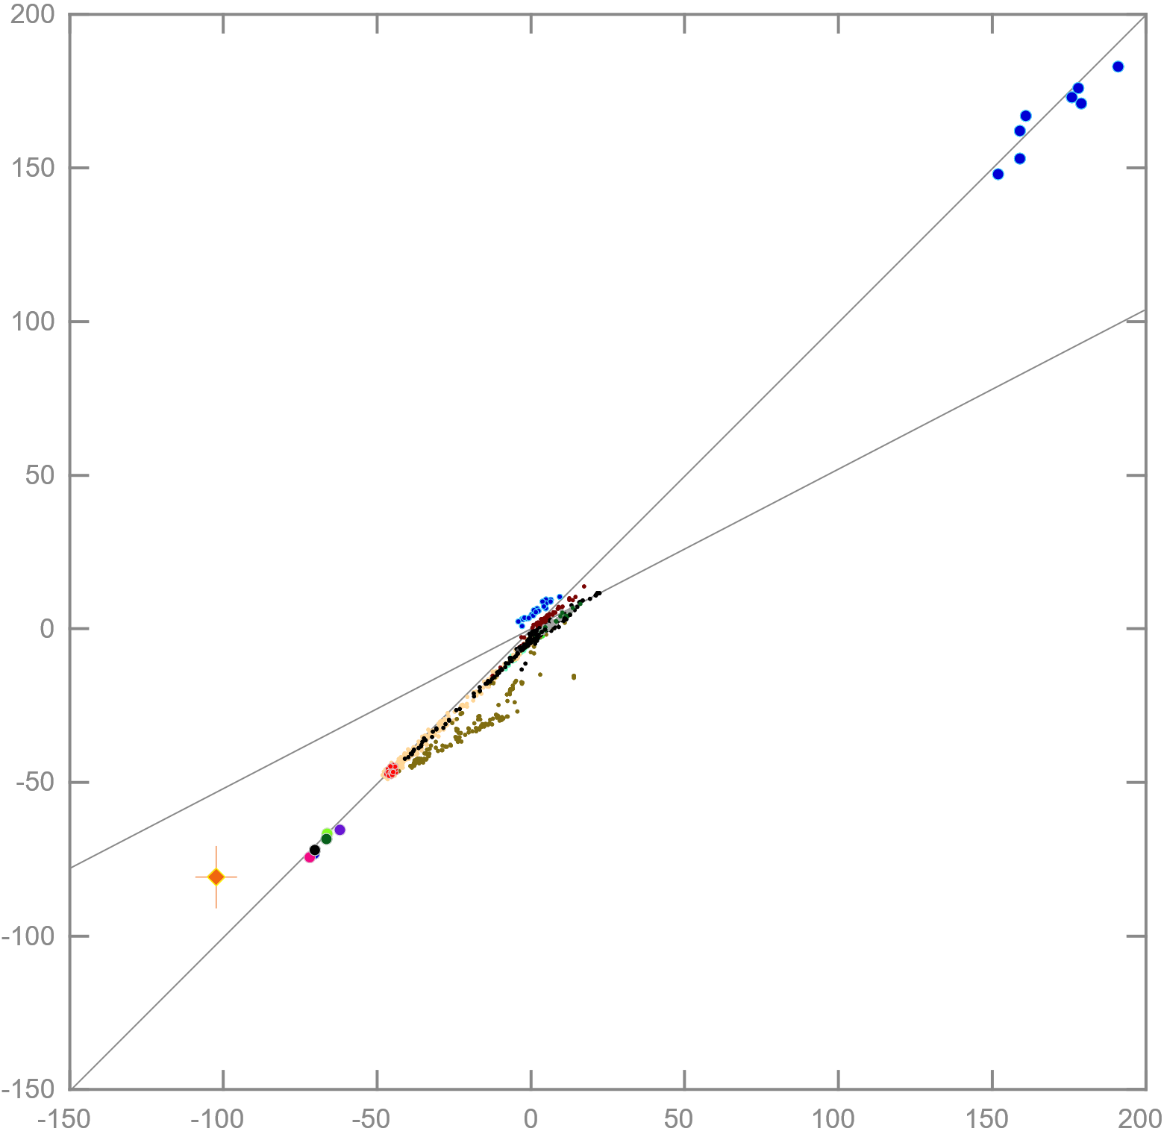
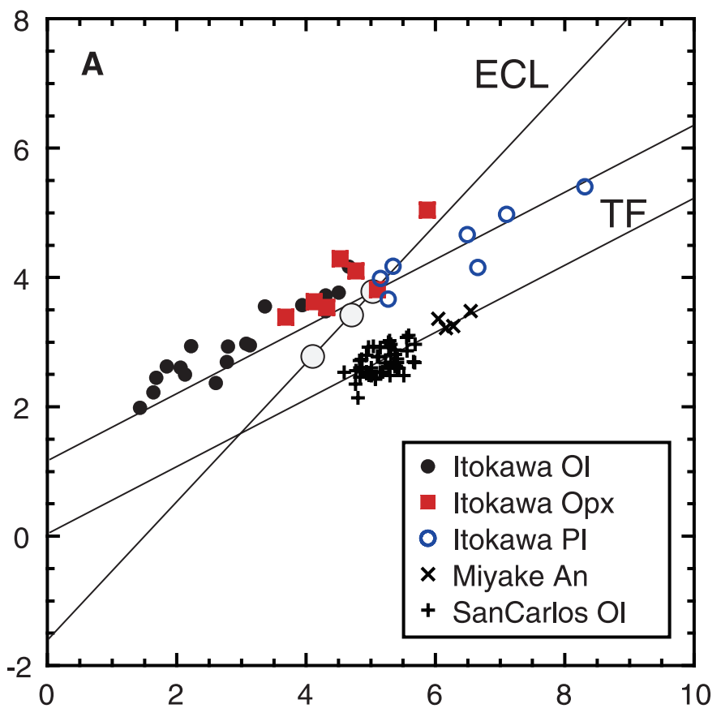
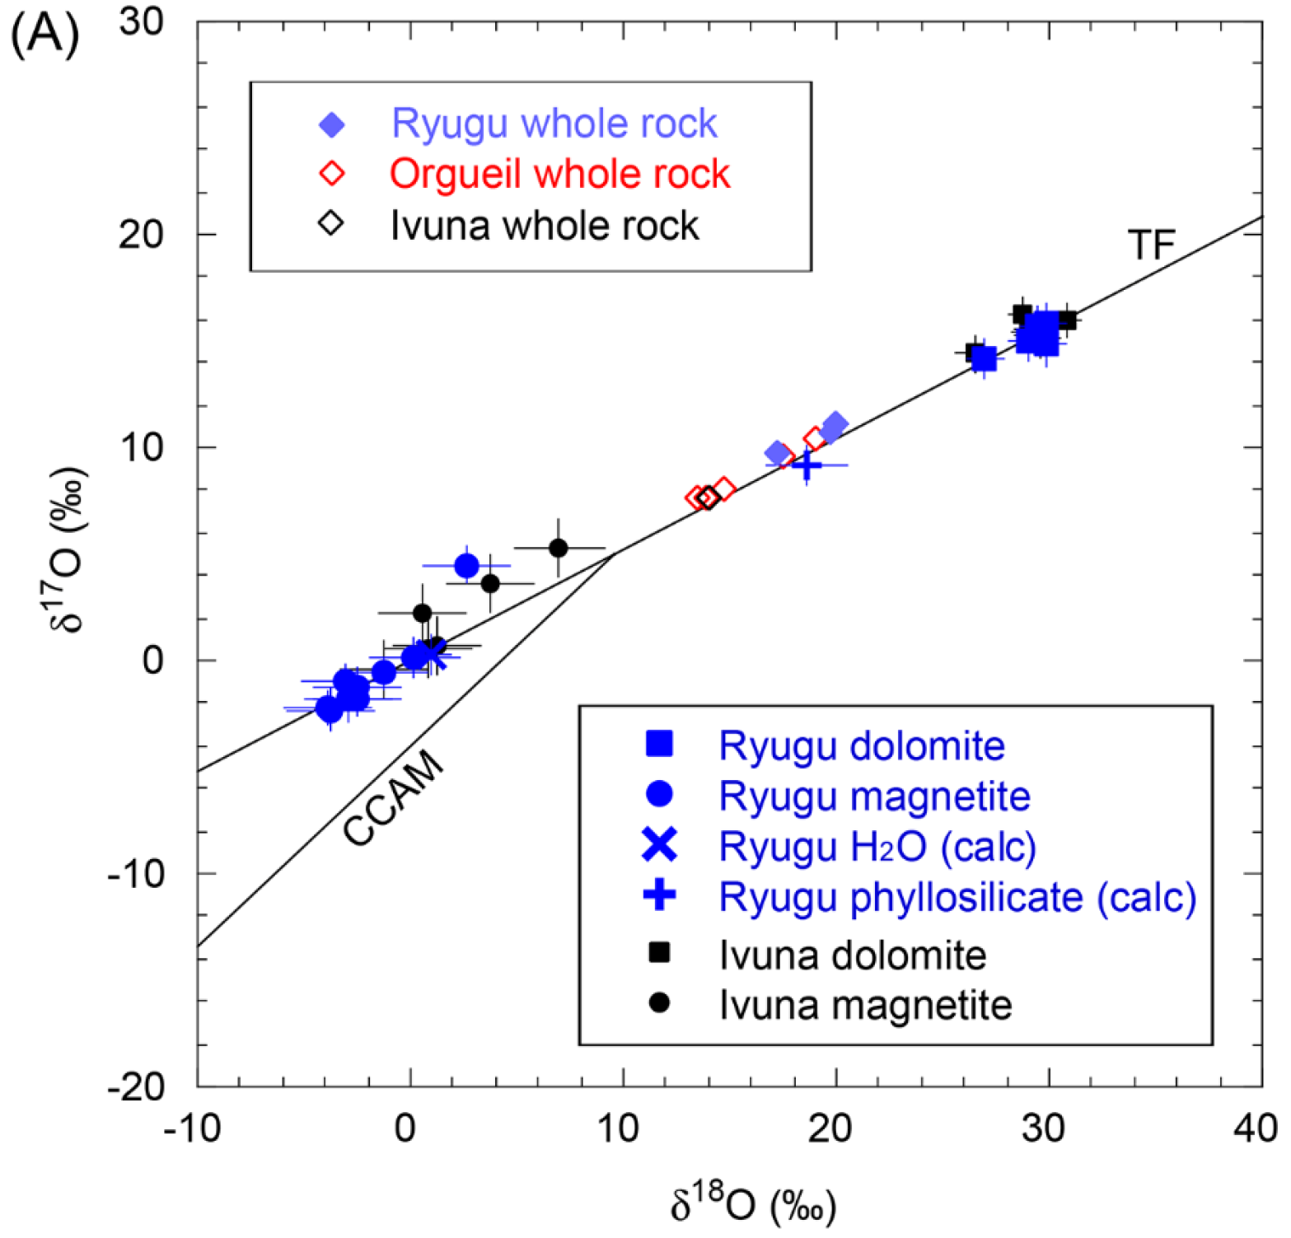
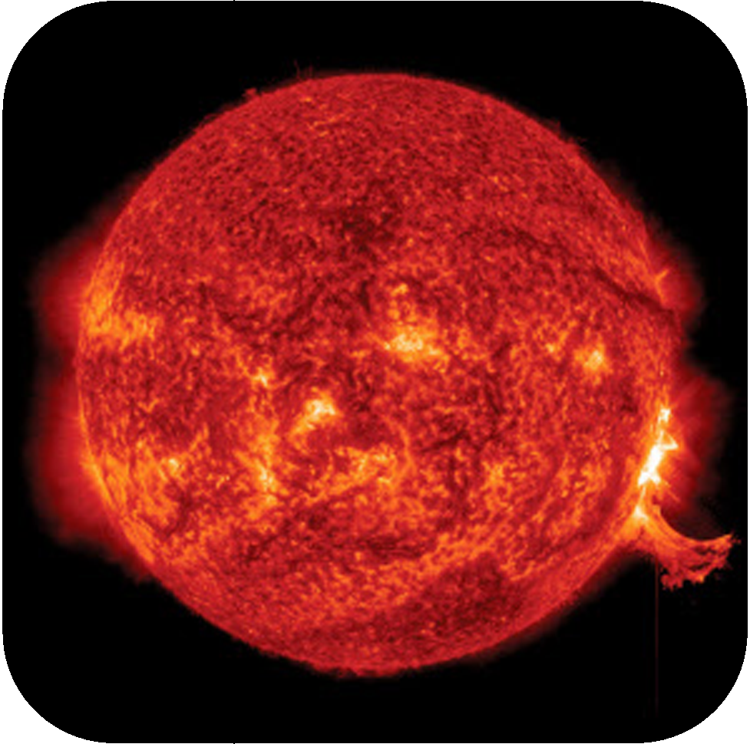
Oxygen
Isotope abundance
Primordial Water
¹⁶O : 99.757
¹⁷O : 0.038
¹⁸O : 0.205
HAYABUSA
Yurimoto, Sakamoto et al. 2011 Science
Cosmic Symplectite
Sakamoto et al. 2007 Science
Asteroid
Itokawa
???
Required Precision
HAYUBUSA2
Earth
Yokoyama, Sakamoto et al. 2022 Science
Precise isotope imaging
for unknown keystones
δ¹⁷O
Solar System Evolution
Asteroid
Ryugu
Mass dependent
Sun
≒
Bulk Solar System
Solar Wind(Genesis mission)
McKeegan et al. 2011 Science
Sakamoto&Kawasaki 2019 Metsoc
Sun
δ¹⁸O
Notes:
One of the biggest mystery of our solar system is why solar system materials are plotted
(click)
not on the mass-dependent fractionation line,
(click)
but formed a simple strange line.
(click)
Asteroid Itokawa and
(click)
asteroid Ryugu are also plotted on here.
(click)
The primordial water is located on a heavy end member
(click)
and the Sun is another.
(click)
Therefore, we understood this solar system line was formed by mixing of primordial water and the Sun.
In order to trace the solar system evolution occurred in this range
(click)
Precision is required.
(click)
Therefore we need precise isotope imaging to find unknown keystones in somewhere not only high spatial resolution.
My job is to find something beyond human knowledge.
From the next slide, I will explain our strategy for the purpose.
２分３０秒

Slide 4

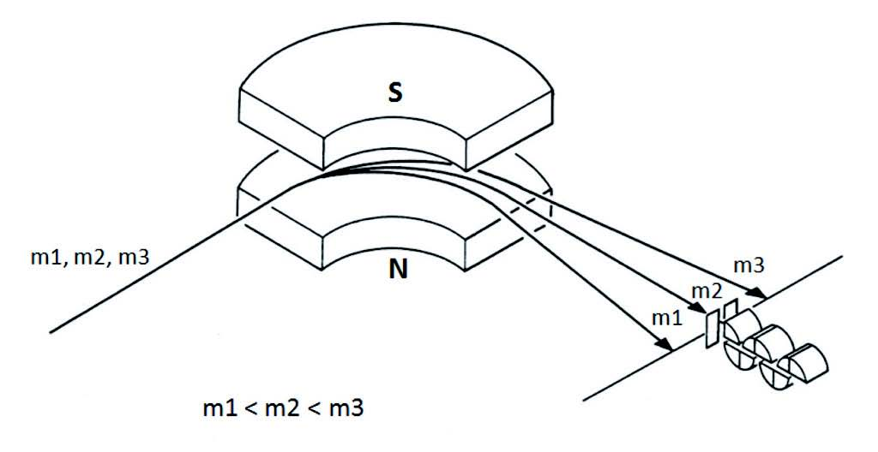
SIMS
Static
Dynamic
Isotope imaging
Magnetic Sector
Time of Flight, Ion Trap
m3
m2
m1
<
<
©JAIMA
Low
1 x 10¹²
ions/cm²
High
Primary
Secondary
Pulse
Continuous
1
<
Duty ratio
1
@ frequency 100 kHz
pulse width 10 ns
1000
Notes:
SIMS is a powerful tool for isotope imaging.
(click)
Relative to the static mode, dynamic SIMS continuously acquires signals at a high duty ratio by irradiating a high intense primary beam.
(click)
Therefore, dynamic SIMS is favorable for our purpose.
３０秒

Slide 5
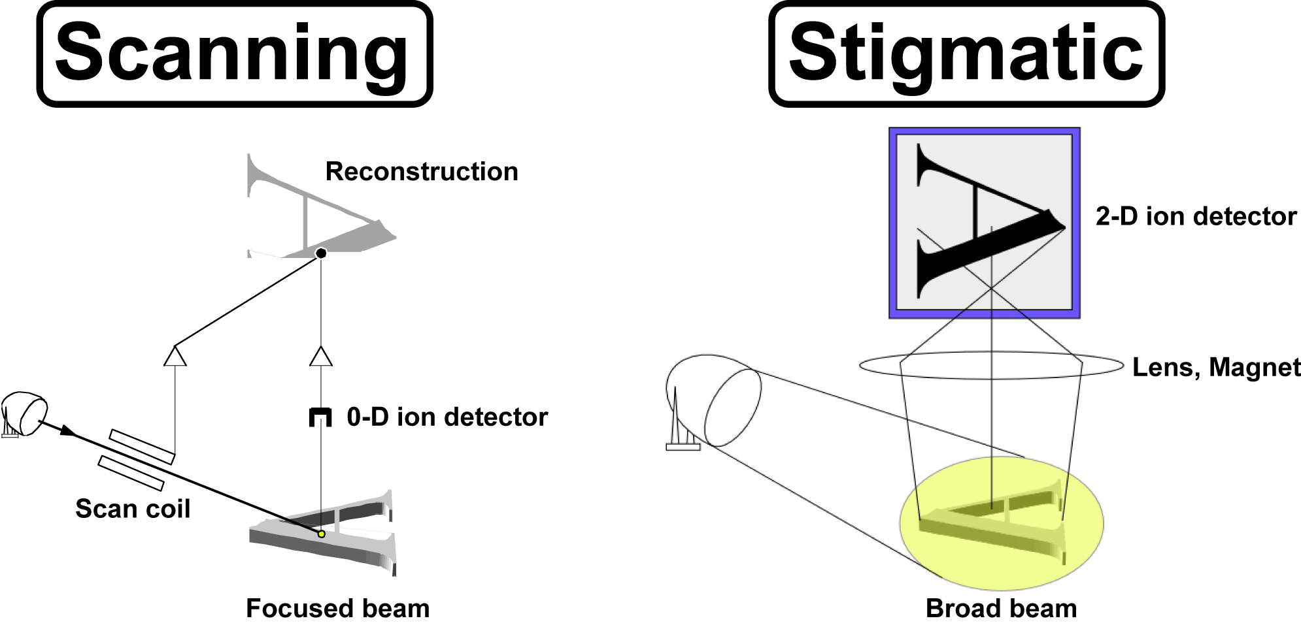
Scanning
Stigmatic
Microbeam < 1 µm
NanoSIMS < 50 nm
FIB, HIM,Cs < 10 nm
High intensity beam
High precision
Wide area
Probe size
Ion optics
Notes:
In terms of imaging method,
The spatial resolution of scanning type is pretty good now, less than 10nm.
But we have to find unknown something that requires precision.
(click)
The stigmatic method has a possibility to make precise isotope analysis for wide area with stigmatic ion optics if we have a good 2-dimentional ion detector.
３０秒

Slide 6
ion
ion
ion
SCAPS
Yurimoto et al., 2003 SIA
MCP+FS+CCD system
  Poor Linearity
  Robustness: poor
  Narrow Dynamic Range
MCP+RAE/PSD system
  Good Linearity
  Robustness: good
  Narrow Dynamic Range
  Large dead time
SCAPS system
  Good Linearity
  Robustness: good
  Wide Dynamic Range
  No dead time
Notes:
Prof. yurimoto and co-workers proposed a 2-dimentional ion imager SCAPS
(click)
having good properties for isotope imaging.
４分

Slide 7
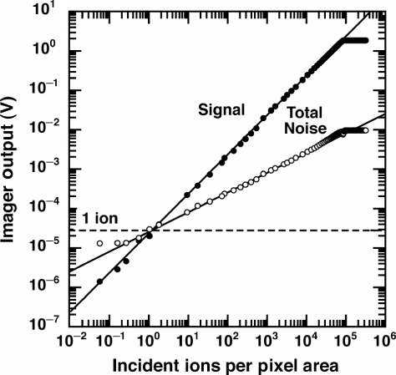
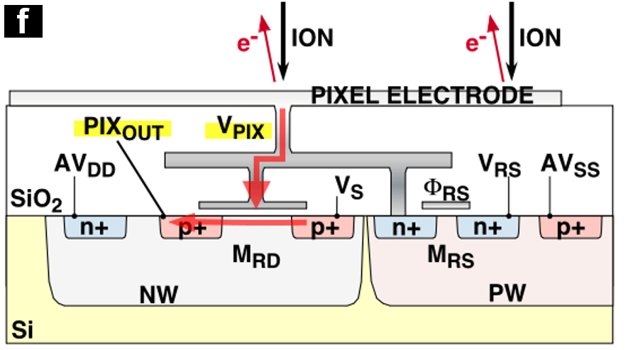
SCAPS
(Stacked CMOS Active Pixel Sensor)
600x576 pixel
Direct ion detection
Robust
Integral type
No dead time
Non-destructive readout
Nagashima+, 2001; Kunihiro+, 2001; Takayanagi+, 2001; Yurimoto+, 2003;
Sakamoto&Yurimoto, 2006; Yamamoto+, 2010; Sakamoto+, 2012
Notes:
SCAPS is a solid state 2 dimensional CMOS type ion detector.
This detector has a pixel electrode in each pixel for direct detection of ions.
This is an output characteristics of a pixel.
You can see this detector has a dynamic range of 4 to 5 order of magnitute for each pixel with good linearity.

Slide 8
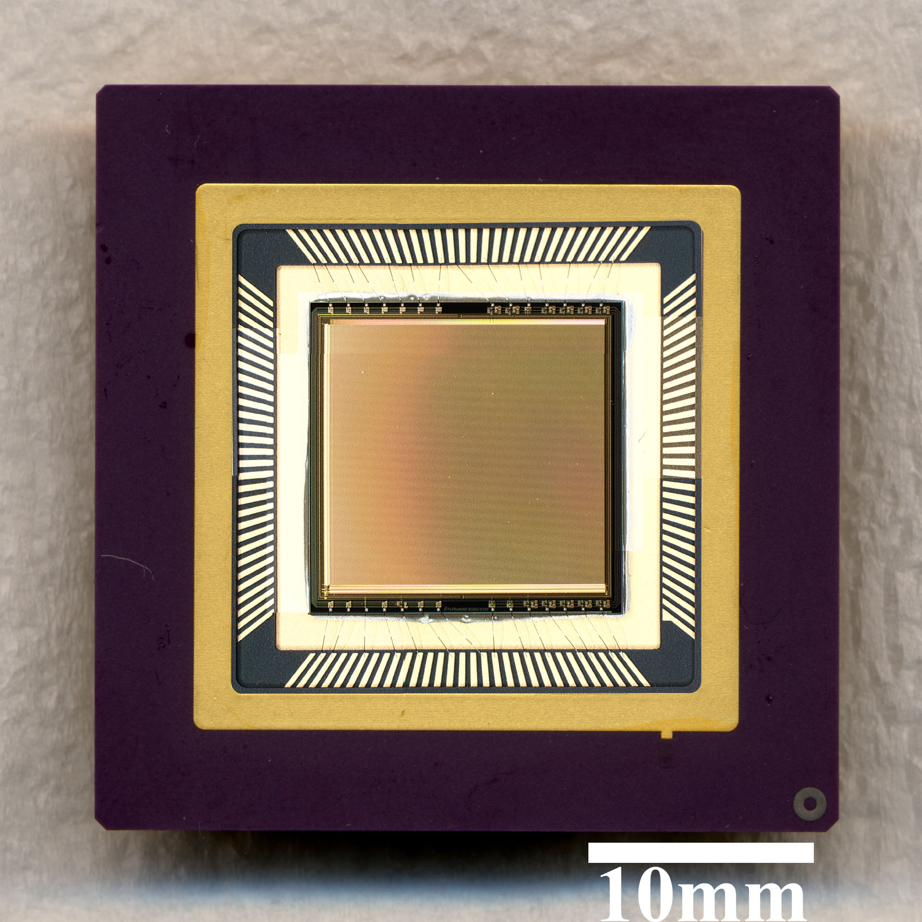
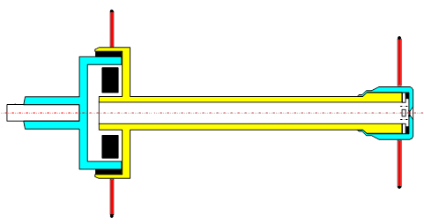
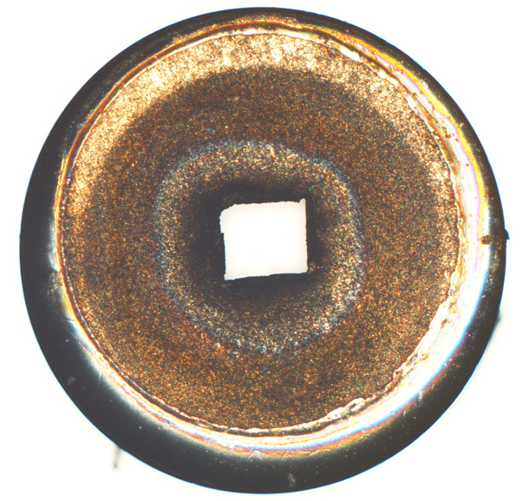
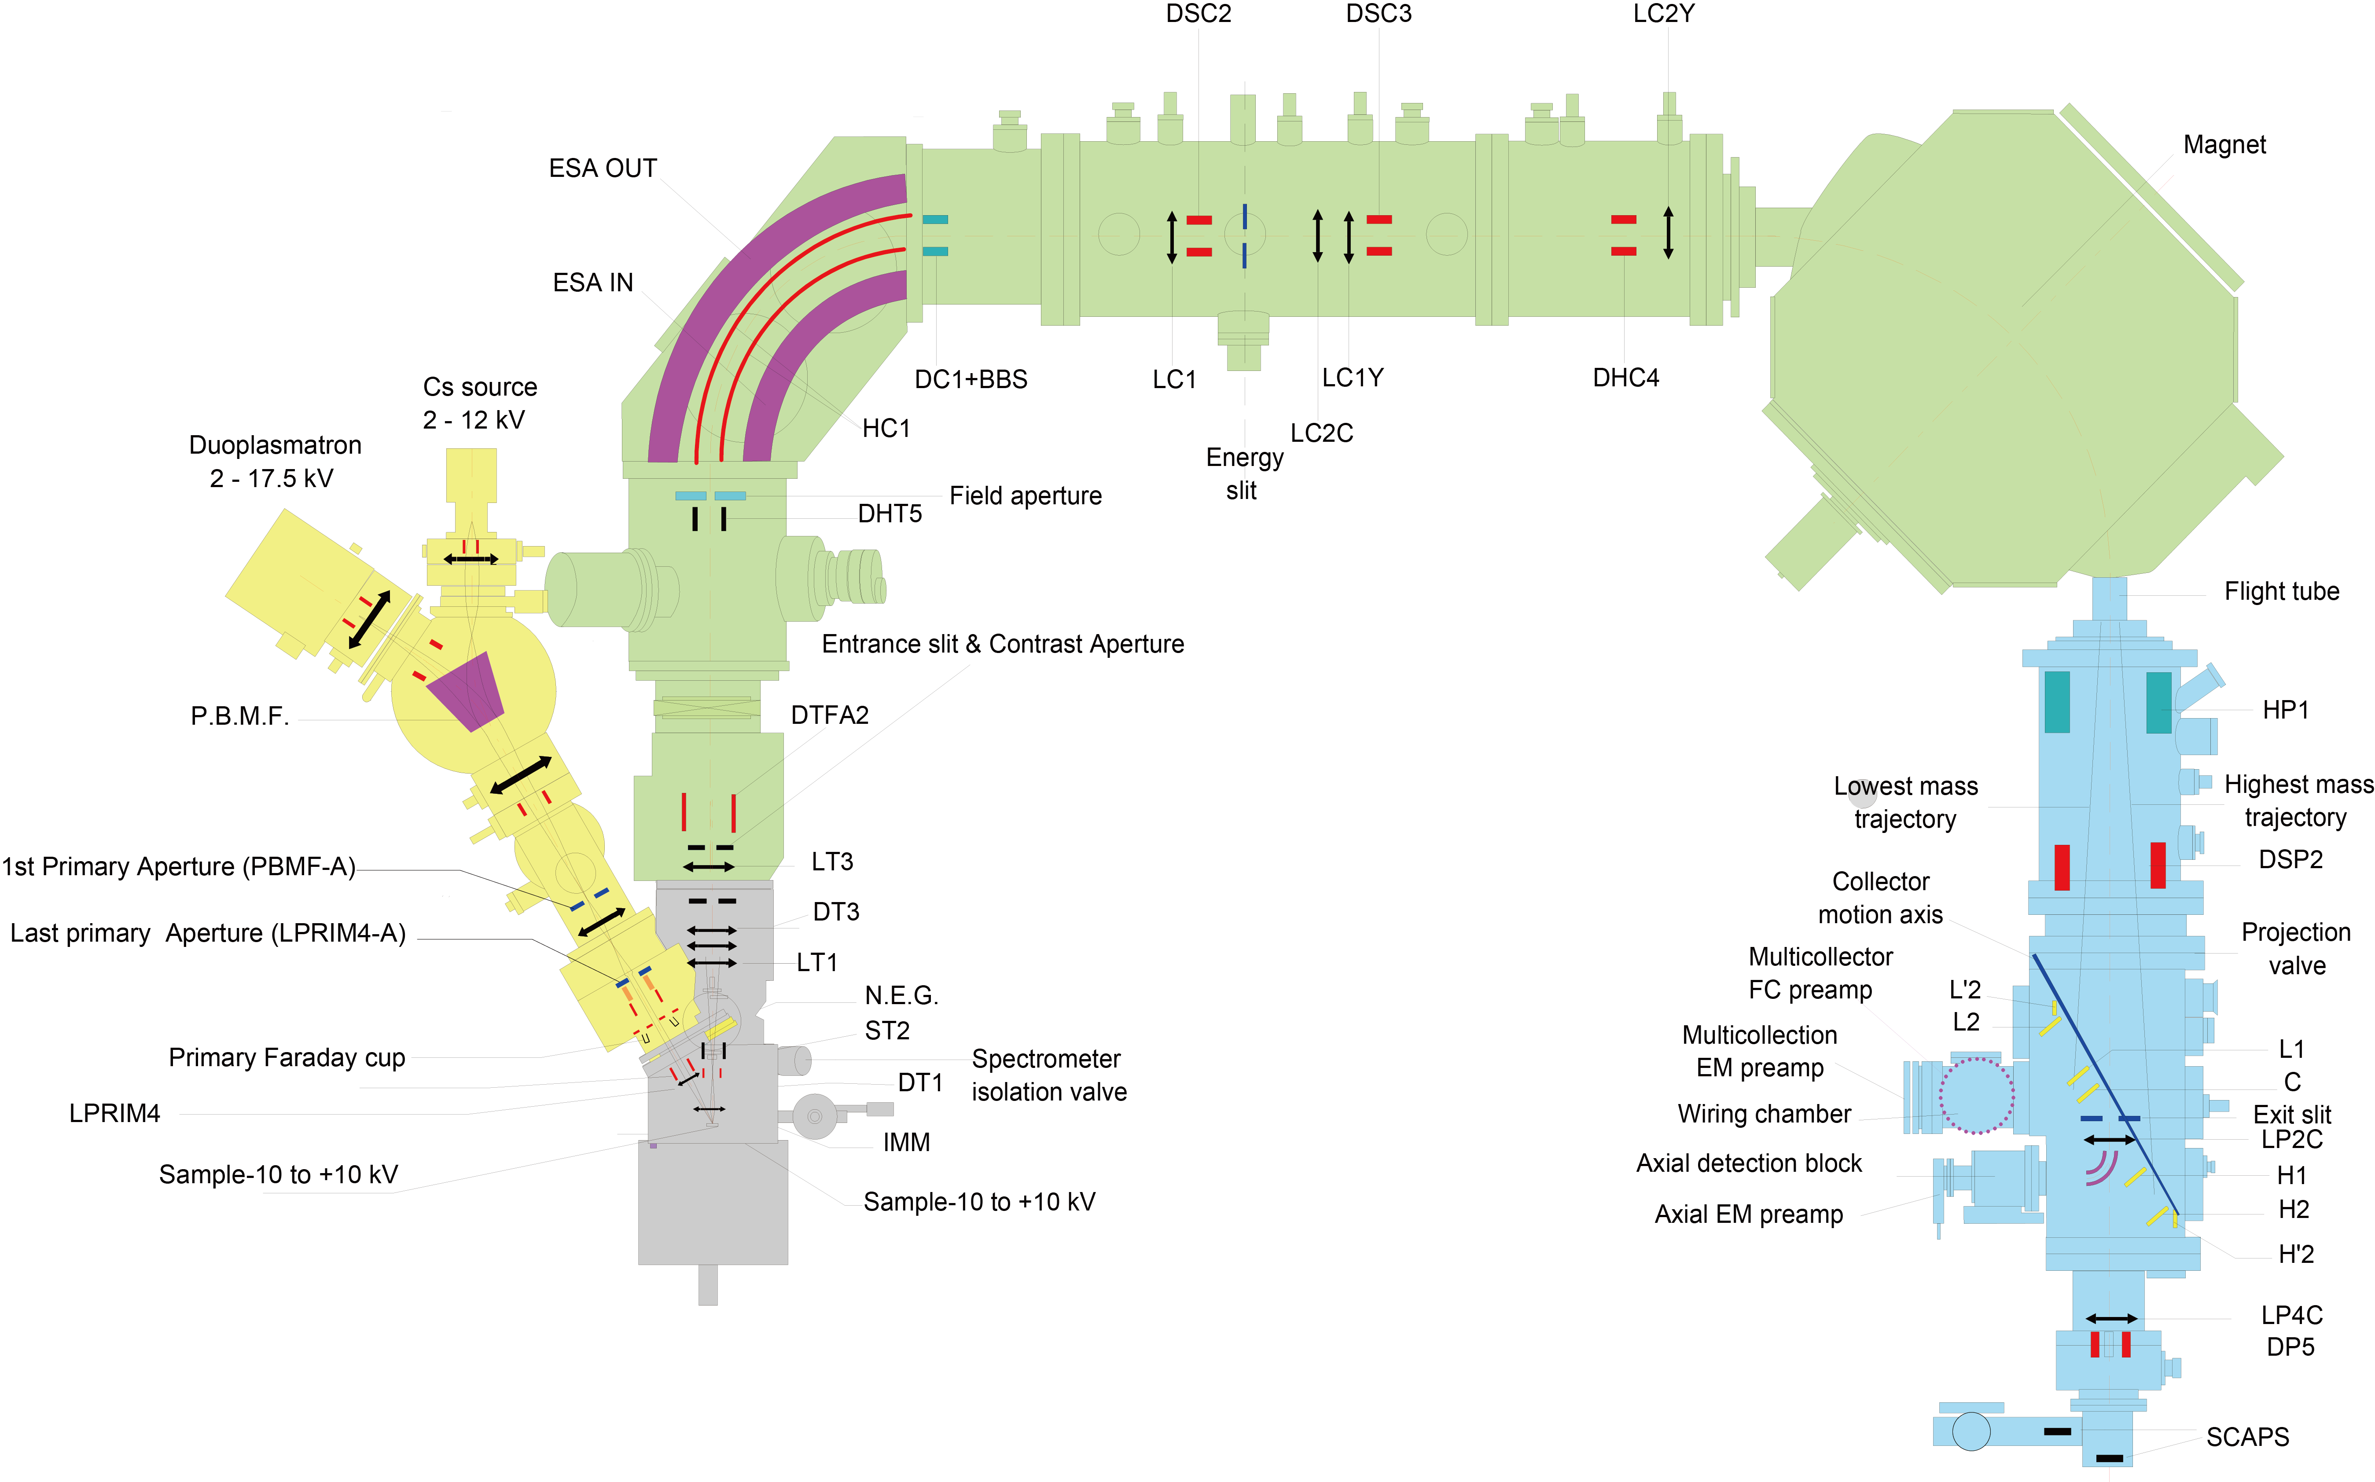
ion source
sample
MS
²⁸Si⁻
Cs⁺
Köhler
Stigmatic
ion optics
SCAPS
aperture
²⁸Si⁻
SIMS
Dynamic
Stigmatic
SCAPS
CAMECA ims series
Notes:
Combination of these elements realized precise isotope imaging.
The primary ion beam is irradiated through the aperture to the sample surface by Kohler illumination.
Secondary ions are separated with magnet and transferred by stigmatic ion optics to SCAPS ion imager.

Slide 9
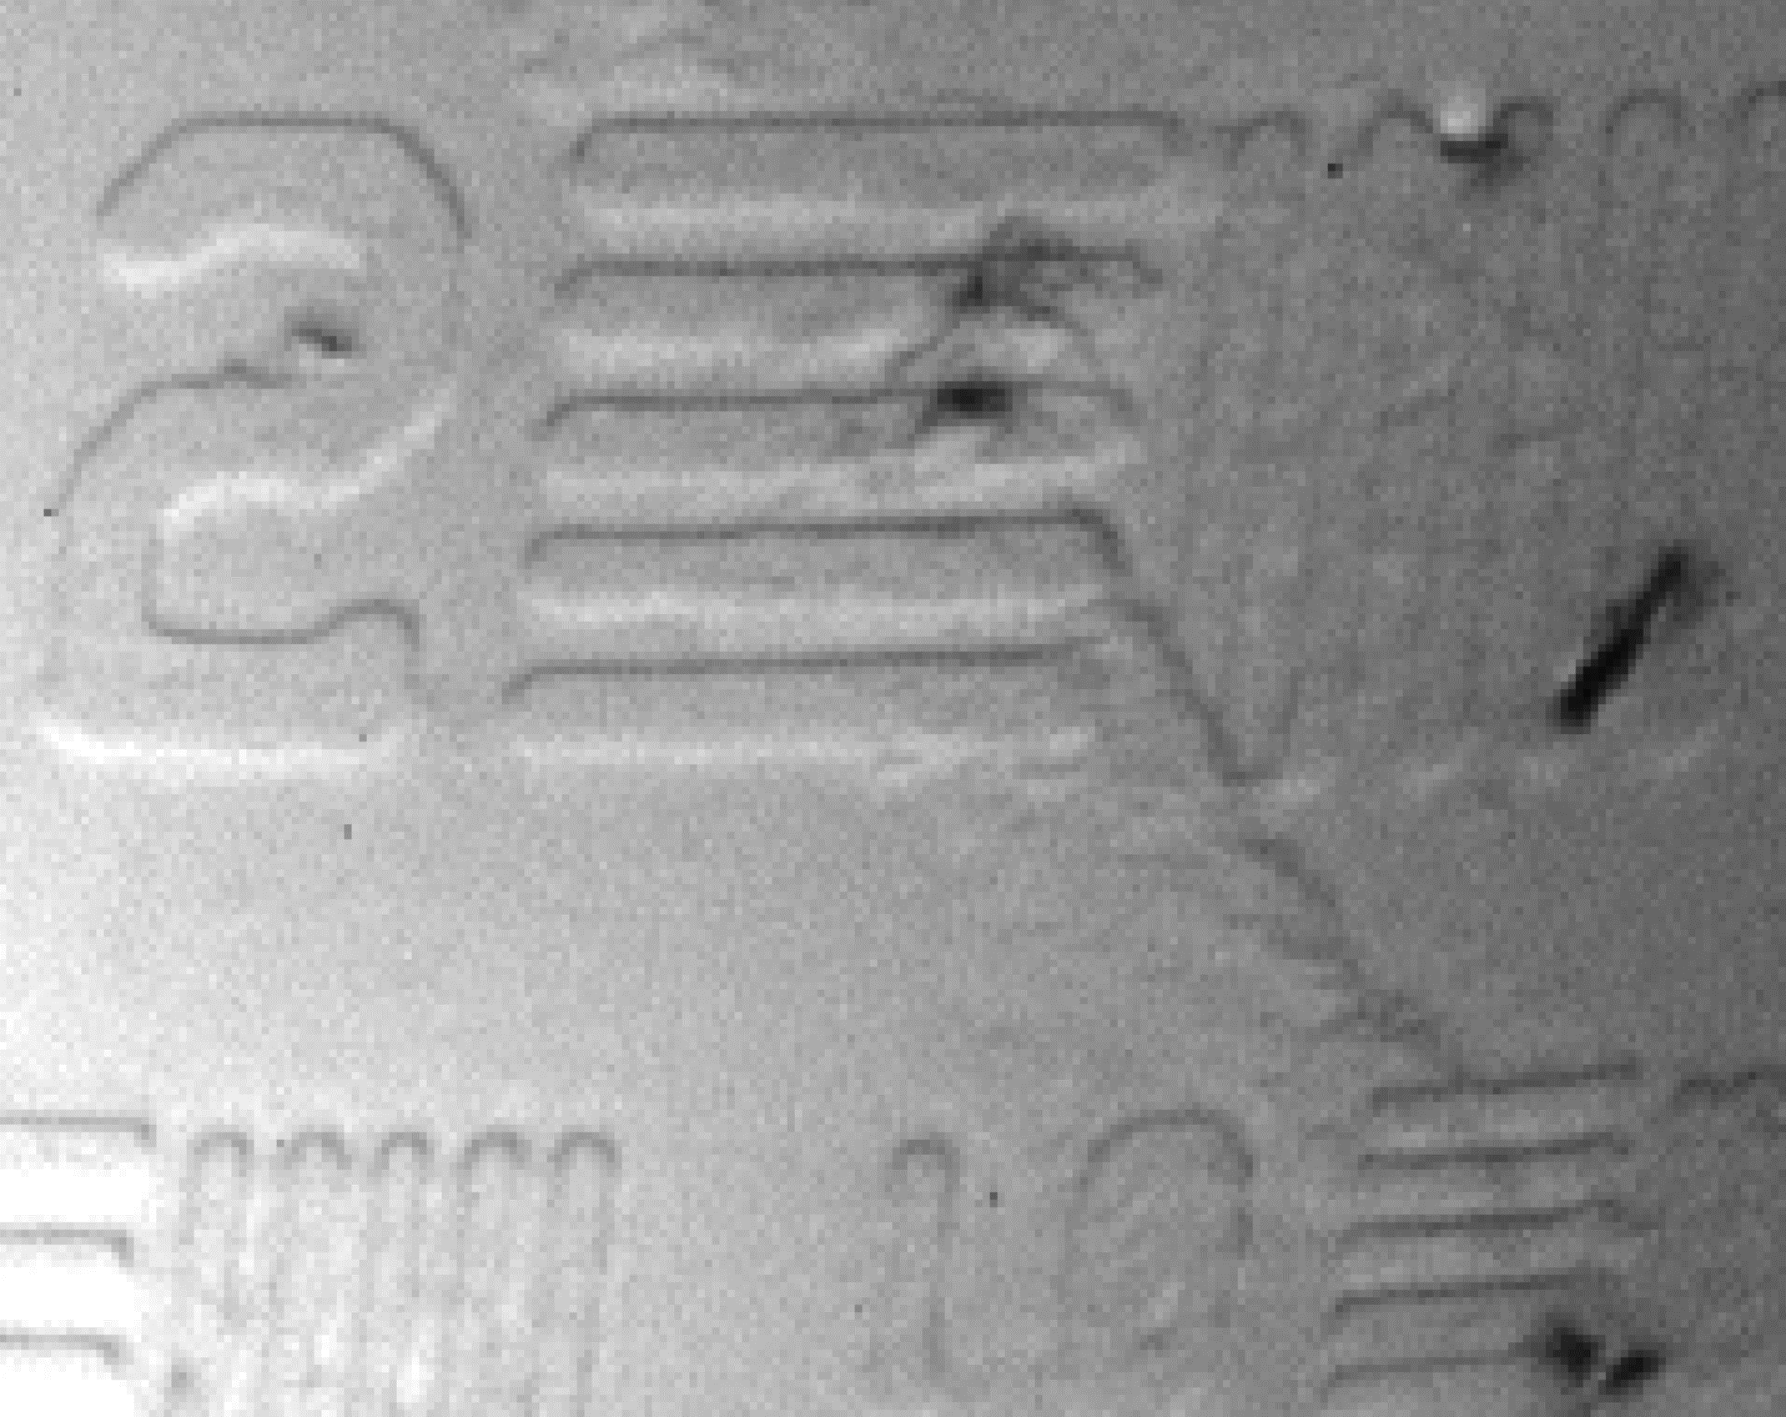
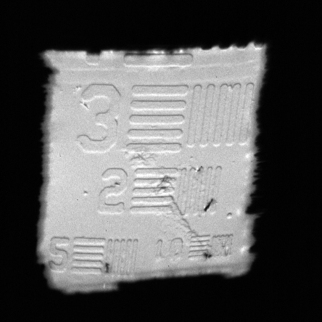
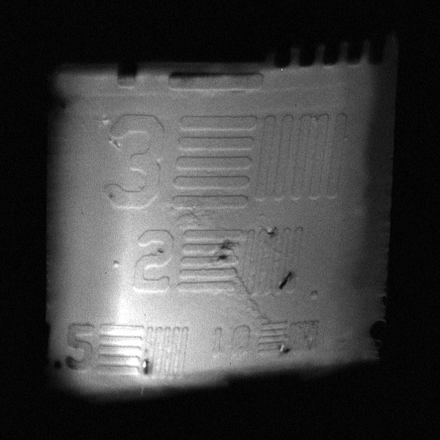
ion source
sample
MS
²⁸Si⁻
Cs⁺
Köhler
Stigmatic
ion optics
SCAPS
aperture
sub-μm resolution with sub-μA beam intensity
²⁸Si⁻
²⁸Si⁻
²⁸Si⁻
SIMS
Dynamic
Stigmatic
SCAPS
4 nA
40 nA
Notes:
This is an example of stigmatic isotope imaging.
This is a silicon isotope image with 4nA primary intensity.
The line width of 3 is 3 microns, 2 is 2 microns.
You can see the beam shape is that of the aperture shape.
This is an image taken by 40 nA primary beam.
Although the Kohler illumination is disturbed, we can see that the spatial resolution is almost the same even 10 times higher beam intensity.
(click)
If we enlarge the 40nA image,
You can also recognize 1 micron bars and small scratches.
(click)
This combination allows the use of a strong primary beam while maintaining submicron resolution.
６分

Slide 10
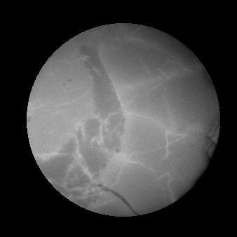
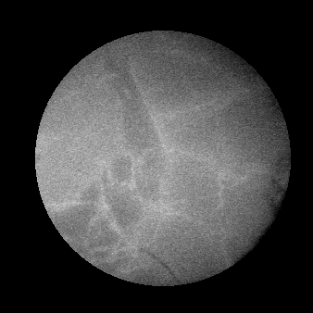
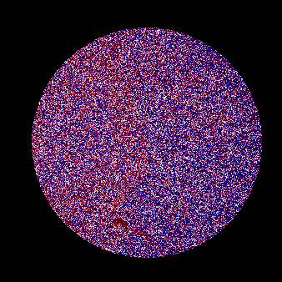
Analysis
sequence
High precision isotope imaging
¹⁶O
¹⁸O
¹⁶O
¹⁸O
¹⁶O
¹⁸O
¹⁶O
¹⁸O
¹⁶O
¹⁸O
¹⁶O
¹⁸O
¹⁶O
¹⁸O
¹⁶O
¹⁸O
¹⁶O
¹⁸O
¹⁶O
¹⁸O
¹⁶O
¹⁸O
¹⁶O
¹⁸O
¹⁶O
¹⁸O
¹⁶O
¹⁸O
¹⁶O
¹⁸O
¹⁶O
¹⁸O
¹⁶O
¹⁸O
¹⁶O
¹⁸O
¹⁶O
¹⁸O
¹⁶O
¹⁸O
¹⁶O
¹⁸O
¹⁸O/¹⁶O
10μm
¹⁶O : 99.757 ¹⁸O : 0.205
-60
20
δ¹⁸O(‰)
Notes:
This is an example of high precision isotope imaging for meteorite.
This is O-16 image, this is O-18 and isotope ratio.
Scale bar is 10um and color scale is -60 to 20 permil.
Compared to O-16, O-18 is less abundant.
Therefore the O-18 image is more rough.

Slide 11

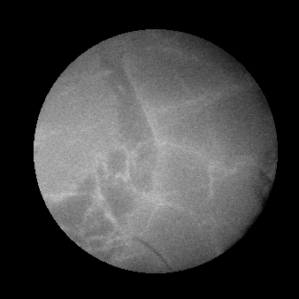
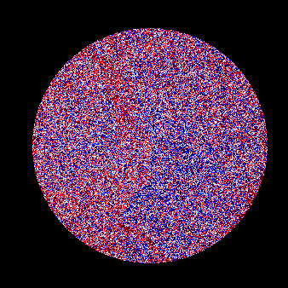
Analysis
sequence
High precision isotope imaging
¹⁶O
¹⁸O
¹⁶O
¹⁸O
¹⁶O
¹⁸O
¹⁶O
¹⁸O
¹⁶O
¹⁸O
¹⁶O
¹⁸O
¹⁶O
¹⁸O
¹⁶O
¹⁸O
¹⁶O
¹⁸O
¹⁶O
¹⁸O
¹⁶O
¹⁸O
¹⁶O
¹⁸O
¹⁶O
¹⁸O
¹⁶O
¹⁸O
¹⁶O
¹⁸O
¹⁶O
¹⁸O
¹⁶O
¹⁸O
¹⁶O
¹⁸O
¹⁶O
¹⁸O
¹⁶O
¹⁸O
¹⁶O
¹⁸O
¹⁸O/¹⁶O
10μm
-60
20
δ¹⁸O(‰)
Notes:
If we have another images and integrate, the roughness of 18O decreases and you can recognize something by your mind’s eye.

Slide 12

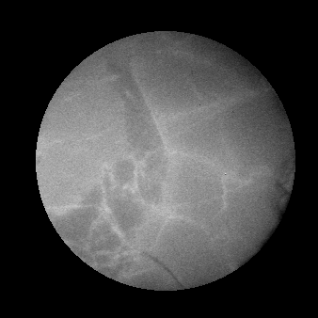
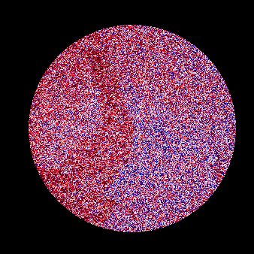
Analysis
sequence
High precision isotope imaging
¹⁶O
¹⁸O
¹⁶O
¹⁸O
¹⁶O
¹⁸O
¹⁶O
¹⁸O
¹⁶O
¹⁸O
¹⁶O
¹⁸O
¹⁶O
¹⁸O
¹⁶O
¹⁸O
¹⁶O
¹⁸O
¹⁶O
¹⁸O
¹⁶O
¹⁸O
¹⁶O
¹⁸O
¹⁶O
¹⁸O
¹⁶O
¹⁸O
¹⁶O
¹⁸O
¹⁶O
¹⁸O
¹⁶O
¹⁸O
¹⁶O
¹⁸O
¹⁶O
¹⁸O
¹⁶O
¹⁸O
¹⁶O
¹⁸O
¹⁸O/¹⁶O
10μm
-60
20
δ¹⁸O(‰)
Notes:
We have to accumulate more to see something

Slide 13


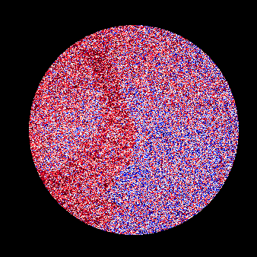
Analysis
sequence
High precision isotope imaging
¹⁶O
¹⁸O
¹⁶O
¹⁸O
¹⁶O
¹⁸O
¹⁶O
¹⁸O
¹⁶O
¹⁸O
¹⁶O
¹⁸O
¹⁶O
¹⁸O
¹⁶O
¹⁸O
¹⁶O
¹⁸O
¹⁶O
¹⁸O
¹⁶O
¹⁸O
¹⁶O
¹⁸O
¹⁶O
¹⁸O
¹⁶O
¹⁸O
¹⁶O
¹⁸O
¹⁶O
¹⁸O
¹⁶O
¹⁸O
¹⁶O
¹⁸O
¹⁶O
¹⁸O
¹⁶O
¹⁸O
¹⁶O
¹⁸O
¹⁸O/¹⁶O
10μm
-60
20
δ¹⁸O(‰)

Slide 14


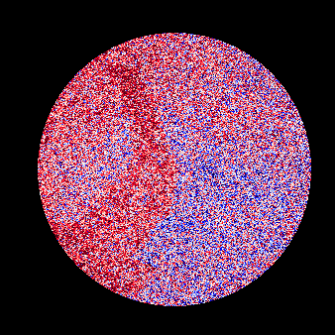
Analysis
sequence
High precision isotope imaging
¹⁶O
¹⁸O
¹⁶O
¹⁸O
¹⁶O
¹⁸O
¹⁶O
¹⁸O
¹⁶O
¹⁸O
¹⁶O
¹⁸O
¹⁶O
¹⁸O
¹⁶O
¹⁸O
¹⁶O
¹⁸O
¹⁶O
¹⁸O
¹⁶O
¹⁸O
¹⁶O
¹⁸O
¹⁶O
¹⁸O
¹⁶O
¹⁸O
¹⁶O
¹⁸O
¹⁶O
¹⁸O
¹⁶O
¹⁸O
¹⁶O
¹⁸O
¹⁶O
¹⁸O
¹⁶O
¹⁸O
¹⁶O
¹⁸O
¹⁸O/¹⁶O
10μm
-60
20
δ¹⁸O(‰)

Slide 15
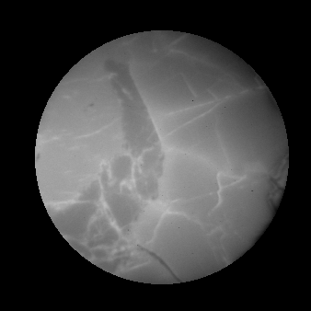

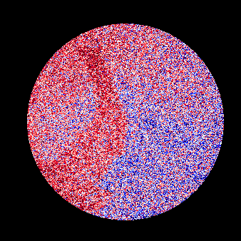
Analysis
sequence
High precision isotope imaging
¹⁶O
¹⁸O
¹⁶O
¹⁸O
¹⁶O
¹⁸O
¹⁶O
¹⁸O
¹⁶O
¹⁸O
¹⁶O
¹⁸O
¹⁶O
¹⁸O
¹⁶O
¹⁸O
¹⁶O
¹⁸O
¹⁶O
¹⁸O
¹⁶O
¹⁸O
¹⁶O
¹⁸O
¹⁶O
¹⁸O
¹⁶O
¹⁸O
¹⁶O
¹⁸O
¹⁶O
¹⁸O
¹⁶O
¹⁸O
¹⁶O
¹⁸O
¹⁶O
¹⁸O
¹⁶O
¹⁸O
¹⁶O
¹⁸O
¹⁸O/¹⁶O
10μm
-60
20
δ¹⁸O(‰)

Slide 16
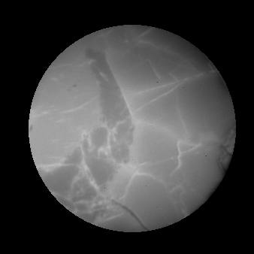

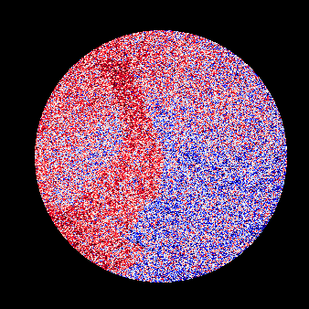
Analysis
sequence
High precision isotope imaging
¹⁶O
¹⁸O
¹⁶O
¹⁸O
¹⁶O
¹⁸O
¹⁶O
¹⁸O
¹⁶O
¹⁸O
¹⁶O
¹⁸O
¹⁶O
¹⁸O
¹⁶O
¹⁸O
¹⁶O
¹⁸O
¹⁶O
¹⁸O
¹⁶O
¹⁸O
¹⁶O
¹⁸O
¹⁶O
¹⁸O
¹⁶O
¹⁸O
¹⁶O
¹⁸O
¹⁶O
¹⁸O
¹⁶O
¹⁸O
¹⁶O
¹⁸O
¹⁶O
¹⁸O
¹⁶O
¹⁸O
¹⁶O
¹⁸O
¹⁸O/¹⁶O
10μm
-60
20
δ¹⁸O(‰)

Slide 17


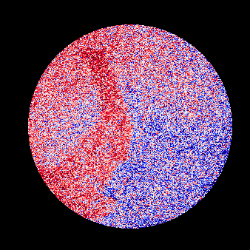
Analysis
sequence
High precision isotope imaging
¹⁶O
¹⁸O
¹⁶O
¹⁸O
¹⁶O
¹⁸O
¹⁶O
¹⁸O
¹⁶O
¹⁸O
¹⁶O
¹⁸O
¹⁶O
¹⁸O
¹⁶O
¹⁸O
¹⁶O
¹⁸O
¹⁶O
¹⁸O
¹⁶O
¹⁸O
¹⁶O
¹⁸O
¹⁶O
¹⁸O
¹⁶O
¹⁸O
¹⁶O
¹⁸O
¹⁶O
¹⁸O
¹⁶O
¹⁸O
¹⁶O
¹⁸O
¹⁶O
¹⁸O
¹⁶O
¹⁸O
¹⁶O
¹⁸O
¹⁸O/¹⁶O
10μm
-60
20
δ¹⁸O(‰)

Slide 18



Analysis
sequence
High precision isotope imaging
¹⁶O
¹⁸O
¹⁶O
¹⁸O
¹⁶O
¹⁸O
¹⁶O
¹⁸O
¹⁶O
¹⁸O
¹⁶O
¹⁸O
¹⁶O
¹⁸O
¹⁶O
¹⁸O
¹⁶O
¹⁸O
¹⁶O
¹⁸O
¹⁶O
¹⁸O
¹⁶O
¹⁸O
¹⁶O
¹⁸O
¹⁶O
¹⁸O
¹⁶O
¹⁸O
¹⁶O
¹⁸O
¹⁶O
¹⁸O
¹⁶O
¹⁸O
¹⁶O
¹⁸O
¹⁶O
¹⁸O
¹⁶O
¹⁸O
¹⁸O/¹⁶O
10μm
-60
20
δ¹⁸O(‰)

Slide 19



Analysis
sequence
High precision isotope imaging
¹⁶O
¹⁸O
¹⁶O
¹⁸O
¹⁶O
¹⁸O
¹⁶O
¹⁸O
¹⁶O
¹⁸O
¹⁶O
¹⁸O
¹⁶O
¹⁸O
¹⁶O
¹⁸O
¹⁶O
¹⁸O
¹⁶O
¹⁸O
¹⁶O
¹⁸O
¹⁶O
¹⁸O
¹⁶O
¹⁸O
¹⁶O
¹⁸O
¹⁶O
¹⁸O
¹⁶O
¹⁸O
¹⁶O
¹⁸O
¹⁶O
¹⁸O
¹⁶O
¹⁸O
¹⁶O
¹⁸O
¹⁶O
¹⁸O
¹⁸O/¹⁶O
10μm
-60
20
δ¹⁸O(‰)

Slide 20


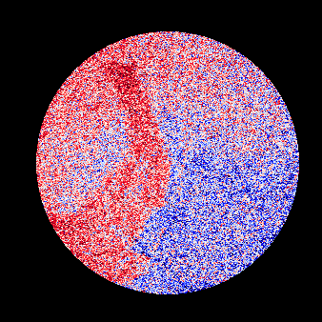
Analysis
sequence
High precision isotope imaging
¹⁶O
¹⁸O
¹⁶O
¹⁸O
¹⁶O
¹⁸O
¹⁶O
¹⁸O
¹⁶O
¹⁸O
¹⁶O
¹⁸O
¹⁶O
¹⁸O
¹⁶O
¹⁸O
¹⁶O
¹⁸O
¹⁶O
¹⁸O
¹⁶O
¹⁸O
¹⁶O
¹⁸O
¹⁶O
¹⁸O
¹⁶O
¹⁸O
¹⁶O
¹⁸O
¹⁶O
¹⁸O
¹⁶O
¹⁸O
¹⁶O
¹⁸O
¹⁶O
¹⁸O
¹⁶O
¹⁸O
¹⁶O
¹⁸O
¹⁸O/¹⁶O
10μm
-60
20
δ¹⁸O(‰)

Slide 21


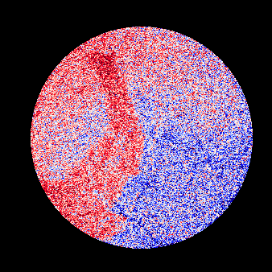
Analysis
sequence
High precision isotope imaging
¹⁶O
¹⁸O
¹⁶O
¹⁸O
¹⁶O
¹⁸O
¹⁶O
¹⁸O
¹⁶O
¹⁸O
¹⁶O
¹⁸O
¹⁶O
¹⁸O
¹⁶O
¹⁸O
¹⁶O
¹⁸O
¹⁶O
¹⁸O
¹⁶O
¹⁸O
¹⁶O
¹⁸O
¹⁶O
¹⁸O
¹⁶O
¹⁸O
¹⁶O
¹⁸O
¹⁶O
¹⁸O
¹⁶O
¹⁸O
¹⁶O
¹⁸O
¹⁶O
¹⁸O
¹⁶O
¹⁸O
¹⁶O
¹⁸O
¹⁸O/¹⁶O
10μm
-60
20
δ¹⁸O(‰)

Slide 22



Analysis
sequence
High precision isotope imaging
¹⁶O
¹⁸O
¹⁶O
¹⁸O
¹⁶O
¹⁸O
¹⁶O
¹⁸O
¹⁶O
¹⁸O
¹⁶O
¹⁸O
¹⁶O
¹⁸O
¹⁶O
¹⁸O
¹⁶O
¹⁸O
¹⁶O
¹⁸O
¹⁶O
¹⁸O
¹⁶O
¹⁸O
¹⁶O
¹⁸O
¹⁶O
¹⁸O
¹⁶O
¹⁸O
¹⁶O
¹⁸O
¹⁶O
¹⁸O
¹⁶O
¹⁸O
¹⁶O
¹⁸O
¹⁶O
¹⁸O
¹⁶O
¹⁸O
¹⁸O/¹⁶O
10μm
-60
20
δ¹⁸O(‰)

Slide 23


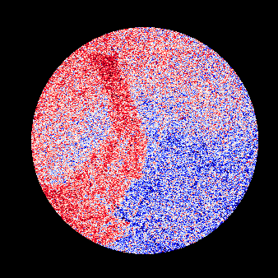
Analysis
sequence
High precision isotope imaging
¹⁶O
¹⁸O
¹⁶O
¹⁸O
¹⁶O
¹⁸O
¹⁶O
¹⁸O
¹⁶O
¹⁸O
¹⁶O
¹⁸O
¹⁶O
¹⁸O
¹⁶O
¹⁸O
¹⁶O
¹⁸O
¹⁶O
¹⁸O
¹⁶O
¹⁸O
¹⁶O
¹⁸O
¹⁶O
¹⁸O
¹⁶O
¹⁸O
¹⁶O
¹⁸O
¹⁶O
¹⁸O
¹⁶O
¹⁸O
¹⁶O
¹⁸O
¹⁶O
¹⁸O
¹⁶O
¹⁸O
¹⁶O
¹⁸O
¹⁸O/¹⁶O
10μm
-60
20
δ¹⁸O(‰)

Slide 24



Analysis
sequence
High precision isotope imaging
¹⁶O
¹⁸O
¹⁶O
¹⁸O
¹⁶O
¹⁸O
¹⁶O
¹⁸O
¹⁶O
¹⁸O
¹⁶O
¹⁸O
¹⁶O
¹⁸O
¹⁶O
¹⁸O
¹⁶O
¹⁸O
¹⁶O
¹⁸O
¹⁶O
¹⁸O
¹⁶O
¹⁸O
¹⁶O
¹⁸O
¹⁶O
¹⁸O
¹⁶O
¹⁸O
¹⁶O
¹⁸O
¹⁶O
¹⁸O
¹⁶O
¹⁸O
¹⁶O
¹⁸O
¹⁶O
¹⁸O
¹⁶O
¹⁸O
¹⁸O/¹⁶O
10μm
-60
20
δ¹⁸O(‰)

Slide 25


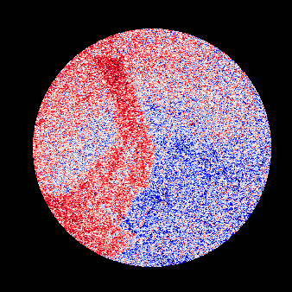
Analysis
sequence
High precision isotope imaging
¹⁶O
¹⁸O
¹⁶O
¹⁸O
¹⁶O
¹⁸O
¹⁶O
¹⁸O
¹⁶O
¹⁸O
¹⁶O
¹⁸O
¹⁶O
¹⁸O
¹⁶O
¹⁸O
¹⁶O
¹⁸O
¹⁶O
¹⁸O
¹⁶O
¹⁸O
¹⁶O
¹⁸O
¹⁶O
¹⁸O
¹⁶O
¹⁸O
¹⁶O
¹⁸O
¹⁶O
¹⁸O
¹⁶O
¹⁸O
¹⁶O
¹⁸O
¹⁶O
¹⁸O
¹⁶O
¹⁸O
¹⁶O
¹⁸O
¹⁸O/¹⁶O
10μm
-60
20
δ¹⁸O(‰)

Slide 26

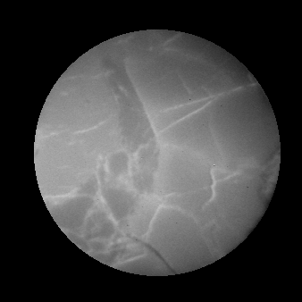
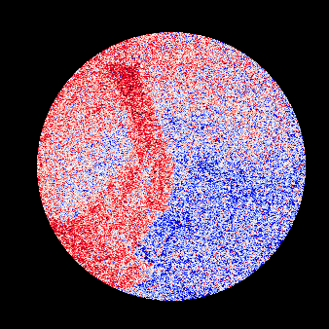
Analysis
sequence
High precision isotope imaging
¹⁶O
¹⁸O
¹⁶O
¹⁸O
¹⁶O
¹⁸O
¹⁶O
¹⁸O
¹⁶O
¹⁸O
¹⁶O
¹⁸O
¹⁶O
¹⁸O
¹⁶O
¹⁸O
¹⁶O
¹⁸O
¹⁶O
¹⁸O
¹⁶O
¹⁸O
¹⁶O
¹⁸O
¹⁶O
¹⁸O
¹⁶O
¹⁸O
¹⁶O
¹⁸O
¹⁶O
¹⁸O
¹⁶O
¹⁸O
¹⁶O
¹⁸O
¹⁶O
¹⁸O
¹⁶O
¹⁸O
¹⁶O
¹⁸O
¹⁸O/¹⁶O
10μm
-60
20
δ¹⁸O(‰)

Slide 27



Analysis
sequence
High precision isotope imaging
¹⁶O
¹⁸O
¹⁶O
¹⁸O
¹⁶O
¹⁸O
¹⁶O
¹⁸O
¹⁶O
¹⁸O
¹⁶O
¹⁸O
¹⁶O
¹⁸O
¹⁶O
¹⁸O
¹⁶O
¹⁸O
¹⁶O
¹⁸O
¹⁶O
¹⁸O
¹⁶O
¹⁸O
¹⁶O
¹⁸O
¹⁶O
¹⁸O
¹⁶O
¹⁸O
¹⁶O
¹⁸O
¹⁶O
¹⁸O
¹⁶O
¹⁸O
¹⁶O
¹⁸O
¹⁶O
¹⁸O
¹⁶O
¹⁸O
¹⁸O/¹⁶O
10μm
-60
20
δ¹⁸O(‰)

Slide 28


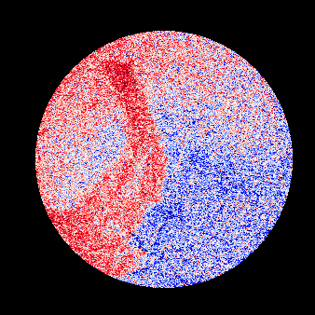
Analysis
sequence
High precision isotope imaging
¹⁶O
¹⁸O
¹⁶O
¹⁸O
¹⁶O
¹⁸O
¹⁶O
¹⁸O
¹⁶O
¹⁸O
¹⁶O
¹⁸O
¹⁶O
¹⁸O
¹⁶O
¹⁸O
¹⁶O
¹⁸O
¹⁶O
¹⁸O
¹⁶O
¹⁸O
¹⁶O
¹⁸O
¹⁶O
¹⁸O
¹⁶O
¹⁸O
¹⁶O
¹⁸O
¹⁶O
¹⁸O
¹⁶O
¹⁸O
¹⁶O
¹⁸O
¹⁶O
¹⁸O
¹⁶O
¹⁸O
¹⁶O
¹⁸O
¹⁸O/¹⁶O
10μm
-60
20
δ¹⁸O(‰)

Slide 29


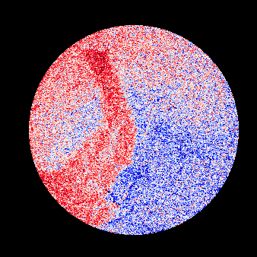
Analysis
sequence
High precision isotope imaging
¹⁶O
¹⁸O
¹⁶O
¹⁸O
¹⁶O
¹⁸O
¹⁶O
¹⁸O
¹⁶O
¹⁸O
¹⁶O
¹⁸O
¹⁶O
¹⁸O
¹⁶O
¹⁸O
¹⁶O
¹⁸O
¹⁶O
¹⁸O
¹⁶O
¹⁸O
¹⁶O
¹⁸O
¹⁶O
¹⁸O
¹⁶O
¹⁸O
¹⁶O
¹⁸O
¹⁶O
¹⁸O
¹⁶O
¹⁸O
¹⁶O
¹⁸O
¹⁶O
¹⁸O
¹⁶O
¹⁸O
¹⁶O
¹⁸O
¹⁸O/¹⁶O
10μm
-60
20
δ¹⁸O(‰)
Notes:
Finally, we can see clear distribution of isotopic composition differences.

Slide 30
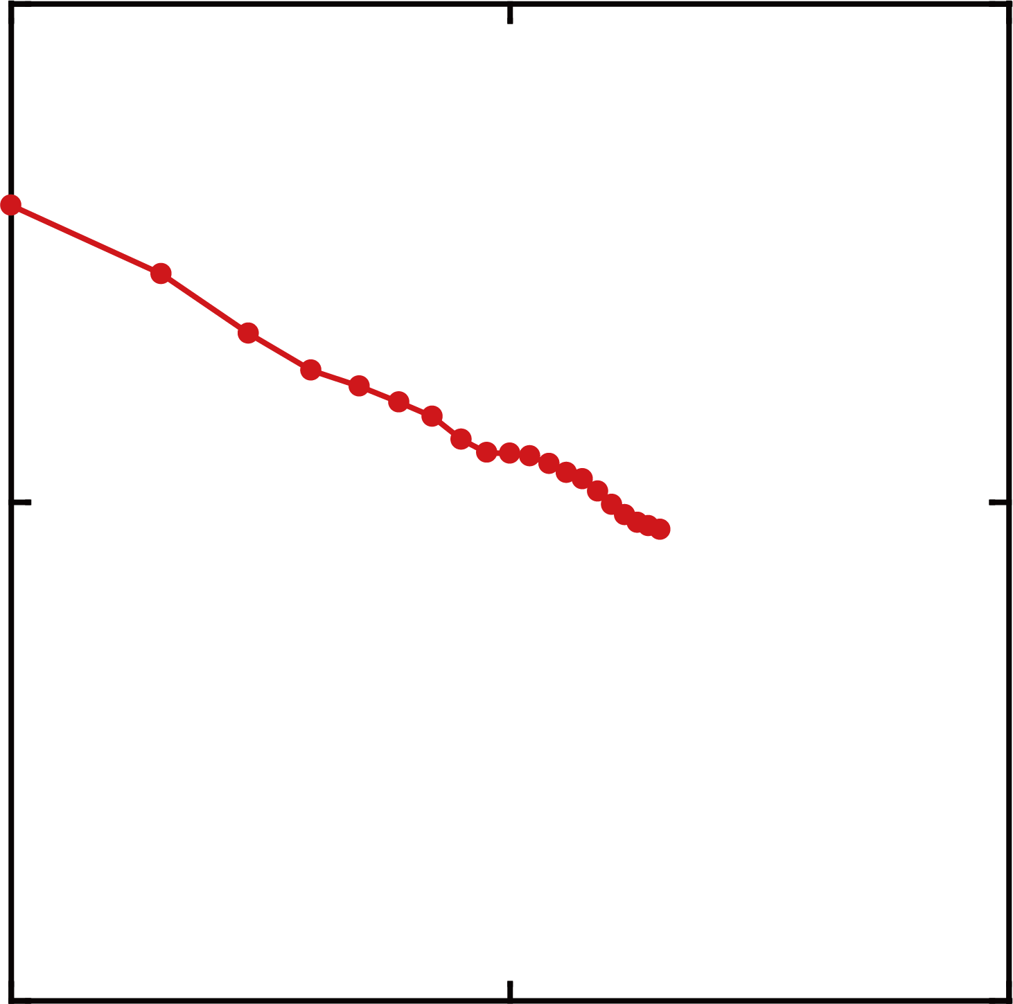
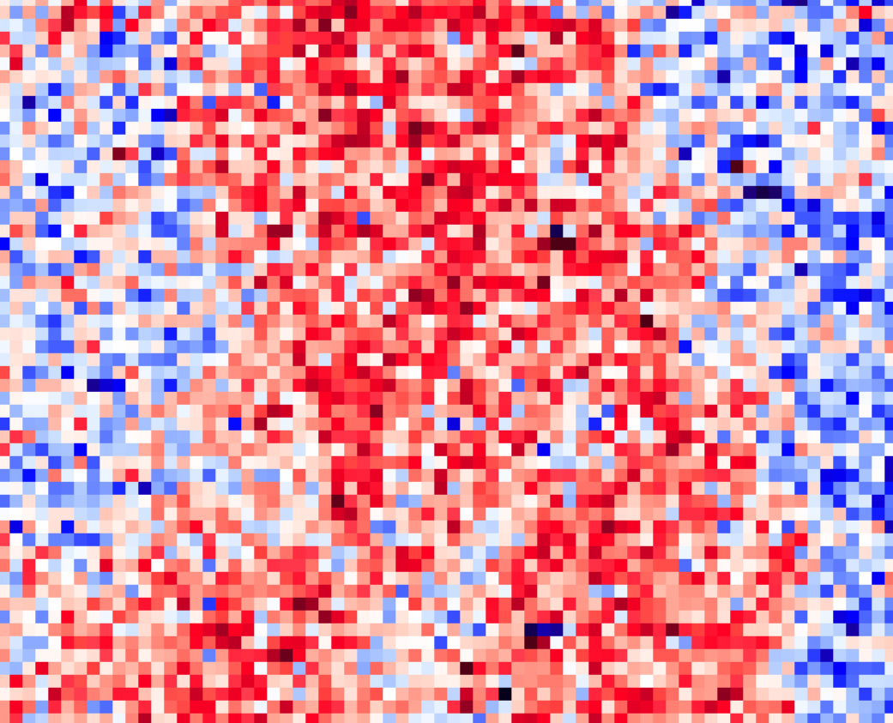

Cumulative
number
¹⁶O
¹⁸O
¹⁸O/¹⁶O
100
10
(‰)
1
slope 1/2
Standard Error
10
1
concentration
Uniform
Standard Deviation
2
10 x 10 pixel
(1 pixel = 0.2 µm)
statistical error :
$$\sqrt{N}$$
(‰)
1
0.1
4
1
10
100
Cumulative number
OK
8
16
10μm
-60
δ¹⁸O(‰)
20
Notes:
Let’s evaluate quantitatively.
(click)
If we calculate this 10 by 10 pixels, the standard deviation decreases as increasing the cumulative number.
When this 2-miron area is calculated as the standard error, the error reaches less than 1 permil.
(click)
The slope of 0.5 indicates the error is statistically decreasing.
(click),
Therefore, high precision isotope imaging is possible less than 1 permil
(click)
if the concentration is uniformly distributed.

Slide 31
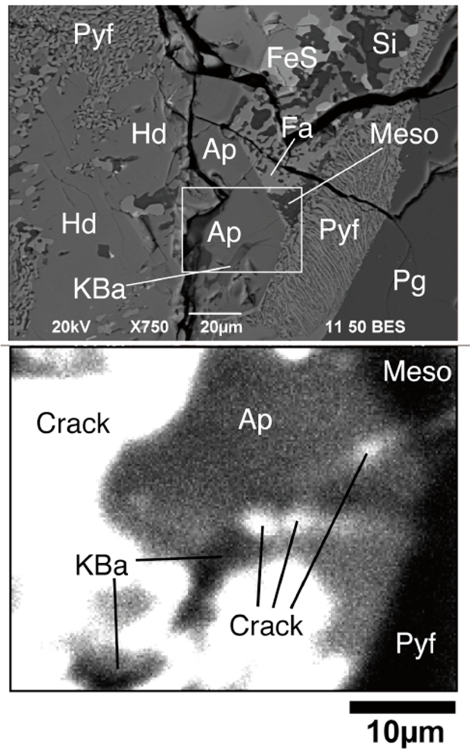
Isotope abundance
Water on the Moon
Water on the Moon
¹H : 99.9885
²H : 0.0115
Apollo11 rock44
¹H⁻
concentration
% ~ ppm
¹H⁻
Dynamic range required for heterogeneous sample
Greenwood, Sakamoto et al. 2011 Nature Geoscience
Notes:
How about this case?
This is a moon rock brought back by apollo 11.
As you can see, we found that the lunar apatite crystals contain a small amount of water.
(click)
In the case of lunar water, the hydrogen concentration is very different among crystals.
Moreover, isotopic abundance ratios differ by four orders of magnitude.
(click)
For heterogeneous sample like water, we need high dynamic range for precise isotope imaging shown before.

Slide 32
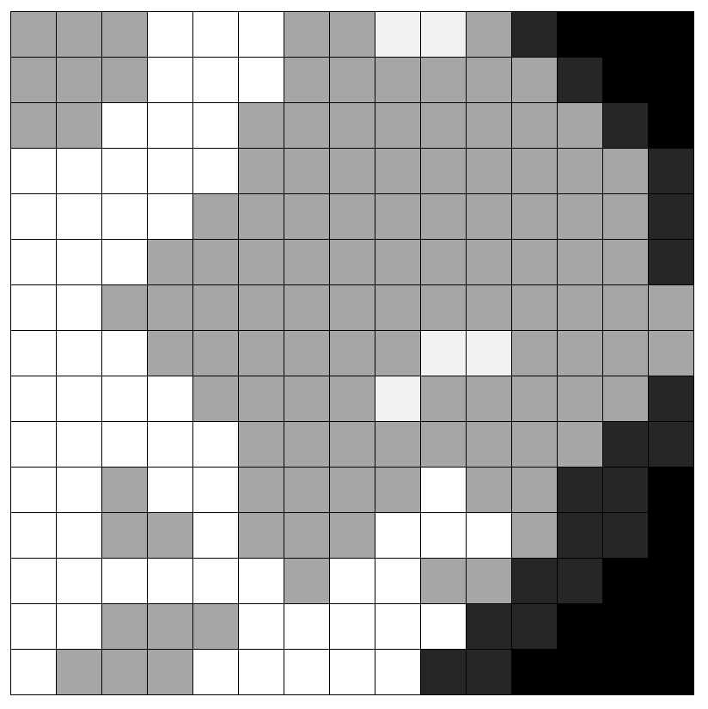
High Dynamic Range (HDR) imaging
by SCAPS ion detector
High ion count
Low ion count
Pixel Reset
No Reset
( Integration )
Signal
Time
Time
Destructive readout
(DRO)
Non-Destructive readout
(NDRO)
Notes:
This is a concept of high dynamic range imaging by SCAPS ion detector.
Pixels with high ion count are reset periodically, while pixels with low ion count continue to accumulate to avoid reset switching noise.

Slide 33
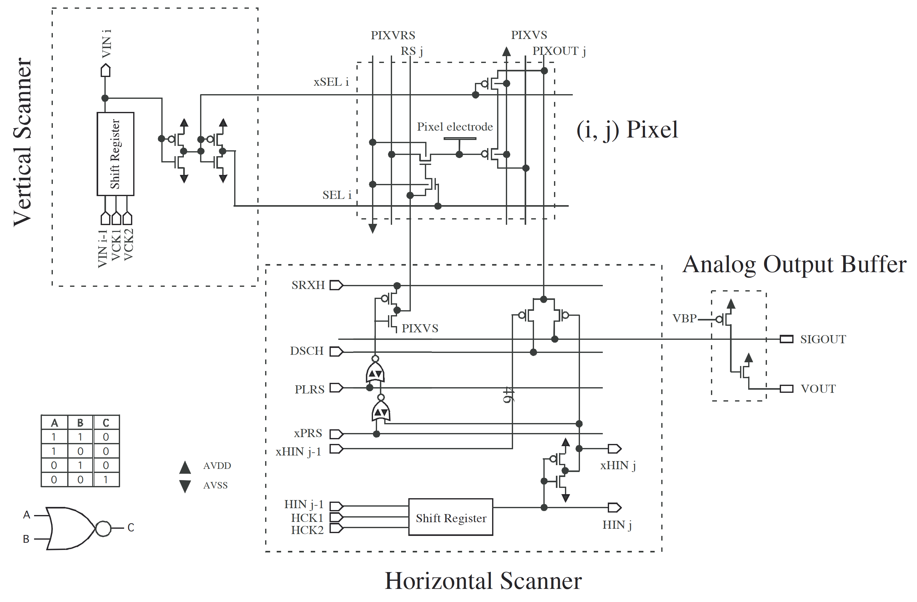

Reset
Readout
Chip Design
Vertical Scanner
Pixel Area
600x576
Horizontal Scanner
AOB
Notes:
This concept is realized by the pixel structure of SCAPS with separate reset and readout circuits
and individual pixel selection ability based on the XY addressing method.

Slide 34
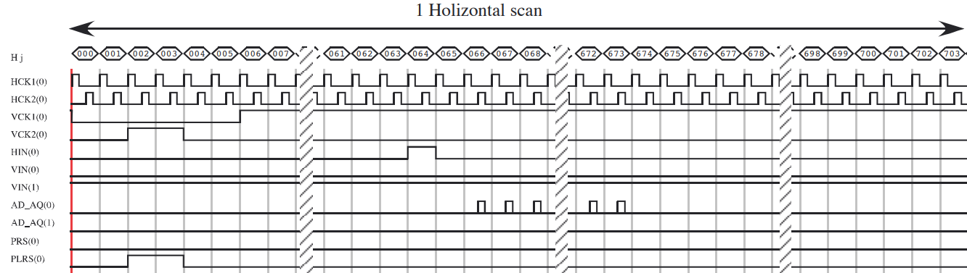
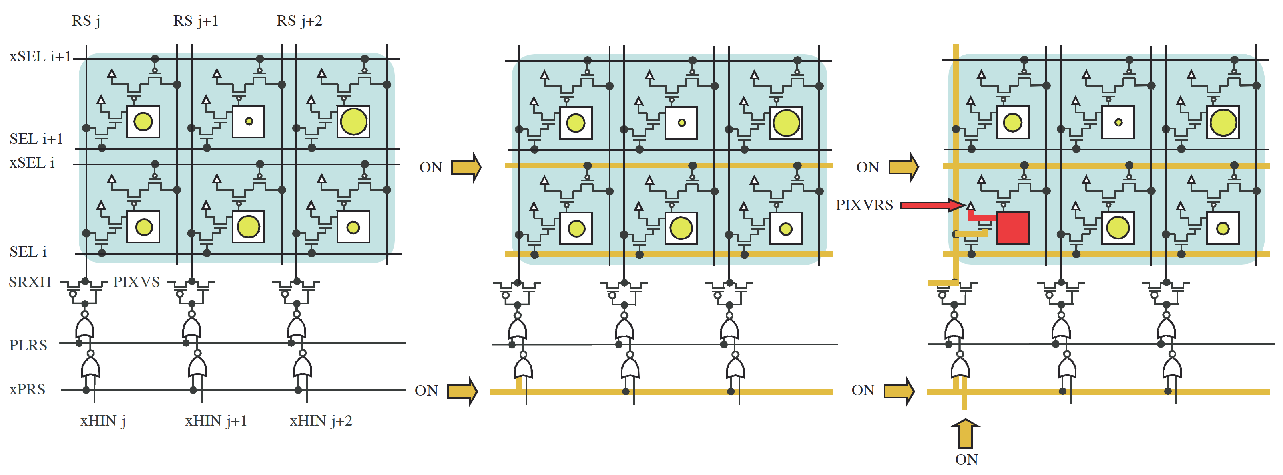
Individual pixel reset
Notes:
This is a pulse timing chart for one line.
Reset pixels can be selected individually using two reset pulses.

Slide 35



Reference image
Set thresh
2500
²⁴Mg⁺
DRO
2000
MgAl₂O₄
1500
Ion counts / frame / pixel
CaAl₂Si₂O₈
1000
Ca₂(Mg,Al,Si)₂O₇
500
10μm
thresh
0
0
100
200
300
400
500
0
1500
3000
NDRO
Pixel
Ion counts / frame / pixel
Notes:
I will explain how to make HDR image using a magnesium isotope map as an example.
Color scale is here.
(click)
White, back and gray colors are corresponding to these minerals.
(click)
This is a intensity graph of this line.
(click)
Set a threshhold value for reset pixel and non-reset pixel.

Slide 36
DRO-NDRO map
Set thresh
2500
DRO
DRO
2000
1500
NDRO
Ion counts / frame / pixel
1000
500
thresh
0
0
100
200
300
400
500
Change driving pulses by FPGA
NDRO
Pixel
Notes:
Here is a reset pixel map.
FPGA code written by LabVIEW software dynamically generates drive pulses.

Slide 37

DRO-NDRO map
0
10
Total acquired frame
DRO
DRO
x 1000
-1
10
-2
NDRO
Output voltage (V /pixel)
10
NDRO
-3
10
-4
10
1
10
100
1000
Frame number
Notes:
If we obtain 1000 image frames, the output signal from the reset pixel is constant and the output signal from the non-reset pixel increases linearly.
(click)
The final integrated signal is used for non-reset pixels, and the signal from reset pixels is multiplied by the number of frames.

Slide 38


HDR image (Log scale)
0
10
²⁴Mg⁺
Total acquired frame
DRO
DRO
x 1000
-1
10
Stable isotope ratio
Radionuclide dating
Partition coefficient
Dynamics of water by Cryo-DSIMS
10⁸
ions / pixel
-2
NDRO
Output voltage (V /pixel)
10
NDRO
-3
10
-4
10
1
10
100
1000
10
-4
10
-3
10
-2
10
-1
0
1
2
3
4
10
10
10
10
10
Frame number
HDR readout (V)
Notes:
This is a composite image created in that way.
Color is a logarithmic scale from 10 to the minus 4 to 10 to the plus 4.
The signal difference of the squared areas is found to be six orders of magnitude, and even the lower intensity area has a signal of more than three orders of magnitude.
(click)
The high dynamic range ion imaging system allows us to have elemental and stable isotope ratio distributions for highly heterogeneous materials.
The wide range is also effective for precise age dating because the age is calculated by a slope.
This system is helpful for partition coefficient of high pressure materials and the water dynamics in geology and also biology by fully cryogenic dynamic SIMS system.

Slide 40






クライオ同位体顕微鏡
クライオステージ
クライオ搬送容器
クライオ試料ホルダ
液体窒素デュワー
環境制御型エアロック
Notes:
そこで、凍結試料を分析できるダイナミックSIMSであるクライオ同位体顕微鏡を開発しました。
前処理された試料を、クライオ搬送容器で運び、環境制御型エアロックを使って、超高真空の装置内部に導入し、クライオステージ上で分析します。
（試料ホルダを指す）
最も難しいのは、全て凍結させたままで行う必要がある、試料の前処理です。

Slide 41





クライオ試料前処理システム
月面での試料調整システムに応用
自動プランジ凍結装置
液状試料を浸漬凍結
液体窒素
クライオシャトル
作業スペース
クライオワークステーション
クライオ切断研磨装置（開発中）
研磨ブレード
Notes:
そのために、凍結したまま試料を前処理するシステムを着々と準備してまいりました。
生体や有機薄膜デバイス、DAC試料など、様々な試料に対応できるようになっています。
現在、固い岩石を、凍結したまま液体窒素の中で切断および研磨を行う装置を開発中で、研磨ブレードのテストをしている段階です。
（クリック）
液体窒素中では、試料を直接触ることはできませんので、この開発を通して得た経験は、月面での試料調整システムに応用していけるのではないか、と考えています。

Slide 42








Cryogenic D-SIMS
Cryogenic sample preparation system
Freeze
Expose
Au coat
Cryo SIMS Holder
Transfer in Liquid Nitrogen
Cryo AirLock
Cryo Stage (-190℃)
Analysis (all-night operation available)
Notes:
クライオ分析の流れです。
まずクライオ環境下で表面出し、導電膜塗布を行った後、削り出しのクライオホルダーにセットします。
液体窒素で満たした容器でSIMS装置のそばまで運搬し、クライオエアロックに格納してSIMSのクライオステージに導入します。
あとは通常通りに分析することができます。

Slide 43





Water dynamics in Liver
Highly concentrated in blood vessels
Gradual migration through hepatocytes
¹⁸O water（H₂¹⁸O）
¹⁶O⁻
¹⁸O⁻
¹⁸O/¹⁶O
Blood vessels
Blood vessels
Vein
Vein
Vein
100µm
Notes:
こちらは凍結した肝臓の16O、18O、およびそれらの比をとった同位体比のイメージです。
スケールは１００ミクロンです。
こちらの絵で、赤いほど注入した18Oが多く、真っ赤なものは18O水がたくさん通った血管の断面と思われます。
また、こちらの大きめの血管から、中心静脈に向かって流れていき、静脈の周りで濃く集まっていくグラデーションも読み取れます。
このように、クライオ化に成功したことで、水などの揮発成分を、真空でも逃がさずに同位体分析を行うことができるようになりました。
８分（１５分）

