Slide 1
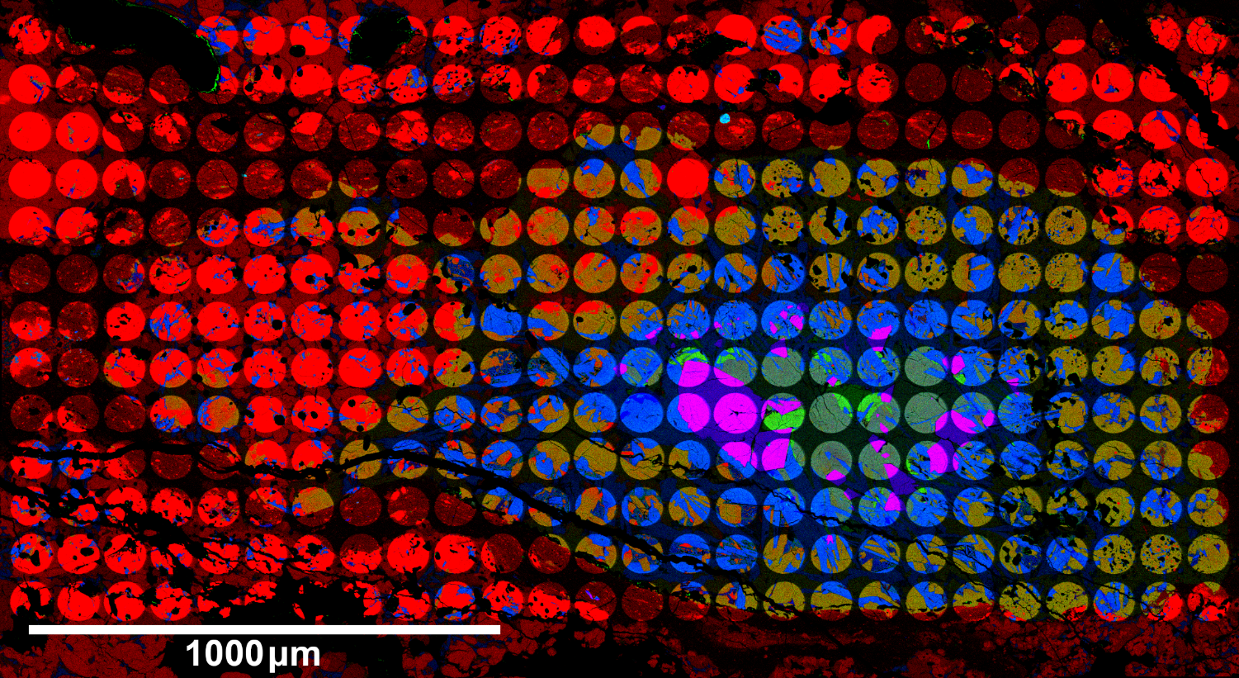
Oxygen isotope distributions of a compound CAI-chondrule object in TIL (Thiel Mountains) 07007 chondrite
N. Sakamoto¹, N. Kawasaki¹, C. Park²
¹Hokkaido U., ²Korea Polar Research Institute
Notes:
Today, I will talk about oxygen isotope distribution of a compound object using isotope mosaic map.
Today’s my talk may be more technical but I hope to introduce my way to enjoy isotope imaging.
Before we get to the topic,

Slide 2
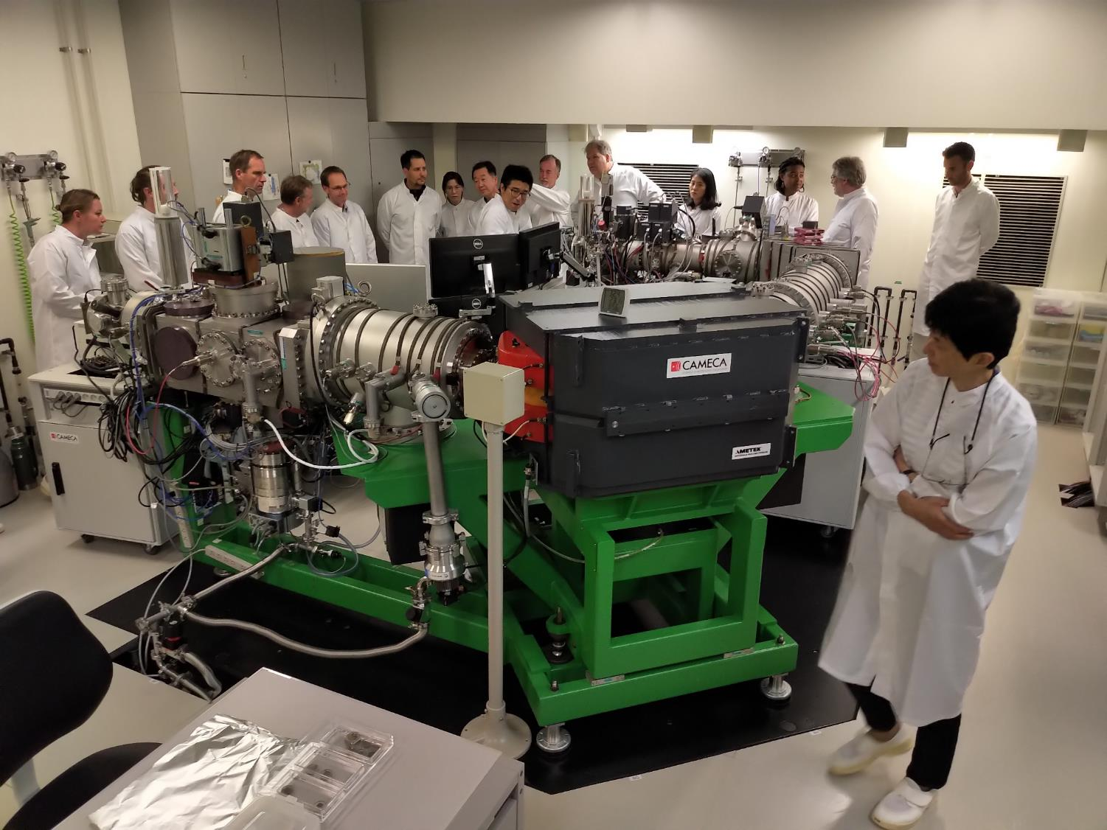
Notes:
Please let me thank for Sapporo metsoc meeting.
This is a picture of lab tour.
Thank you very much to visit our SIMS lab and come back to Hokkaido.
For introduction, let me report the result of measurement we conducted during metsoc meeting.

Slide 3
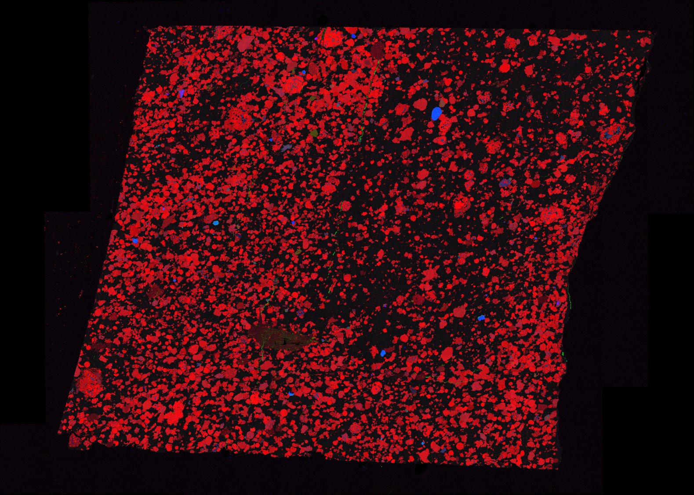
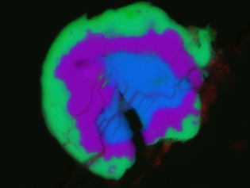
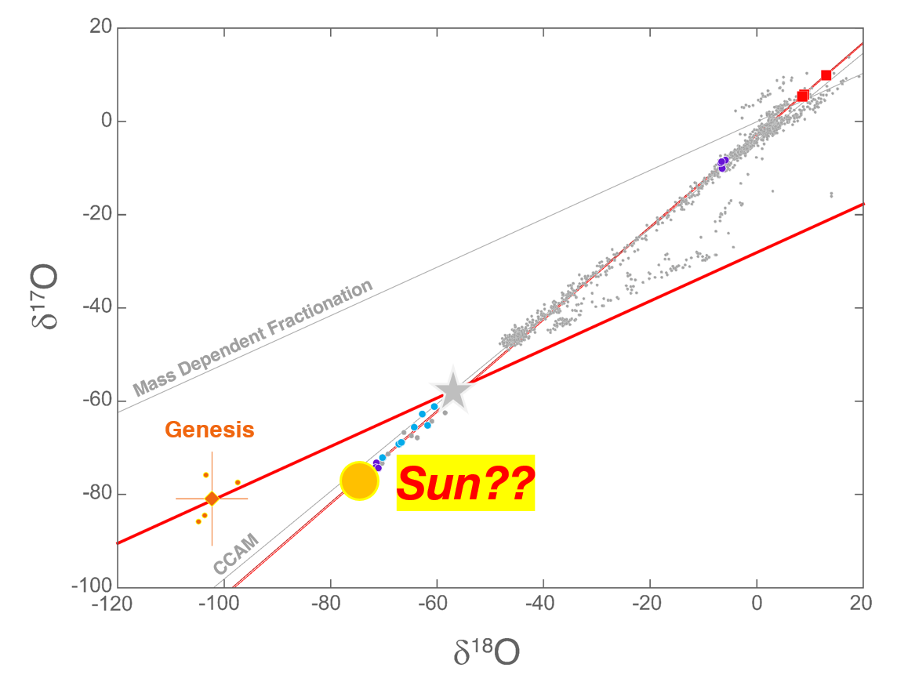
Isheyevo 2-3
10μm
Δ¹⁷O ~ -37‰
Sakamoto and Kawasaki, 2019 metsoc
Notes:
During the lab tour, we had measured this section
(click)
containing one of extremely 16O-rich CAI
(click)
indicating oxygen isotopic composition of the Sun.

Slide 4
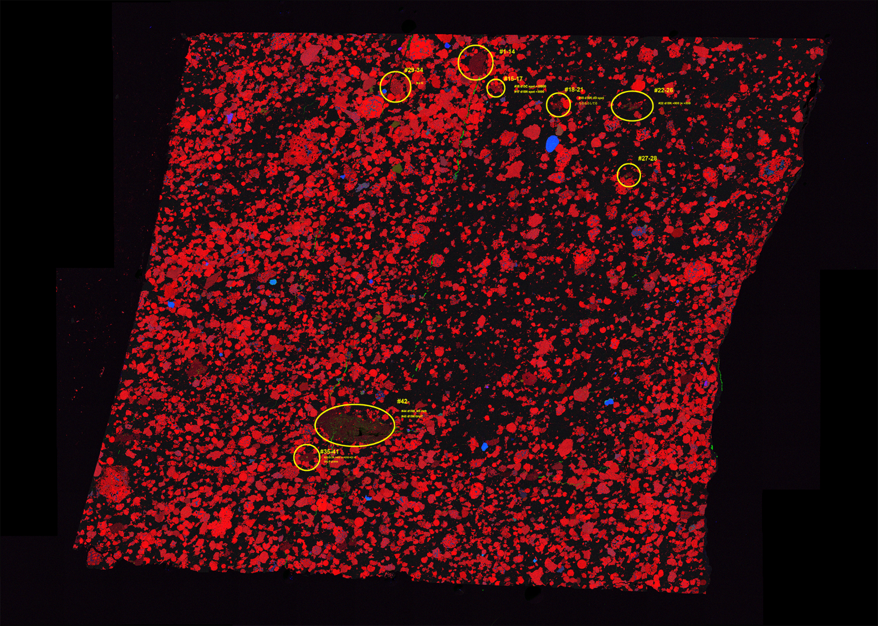
Isheyevo 2-3
¹²C⁻ ¹³C⁻ ¹⁶O⁻ ¹⁷O⁻ ¹⁸O⁻ ¹⁶OH⁻ ¹⁶OD⁻
¹⁹F⁻ ¹²C¹⁴N⁻ ¹²C¹⁵N⁻ ³⁵Cl⁻ ³⁷Cl⁻
Notes:
Yellow circles indicate measured areas for these isotopes during metsoc meeting.
Among these isotopes

Slide 5
Isheyevo 2-3
¹²C⁻ ¹³C⁻ ¹⁶O⁻ ¹⁷O⁻ ¹⁸O⁻ ¹⁶OH⁻ ¹⁶OD⁻
¹⁹F⁻ ¹²C¹⁴N⁻ ¹²C¹⁵N⁻ ³⁵Cl⁻ ³⁷Cl⁻
Notes:
I will show you the result of nitrogen.

Slide 6
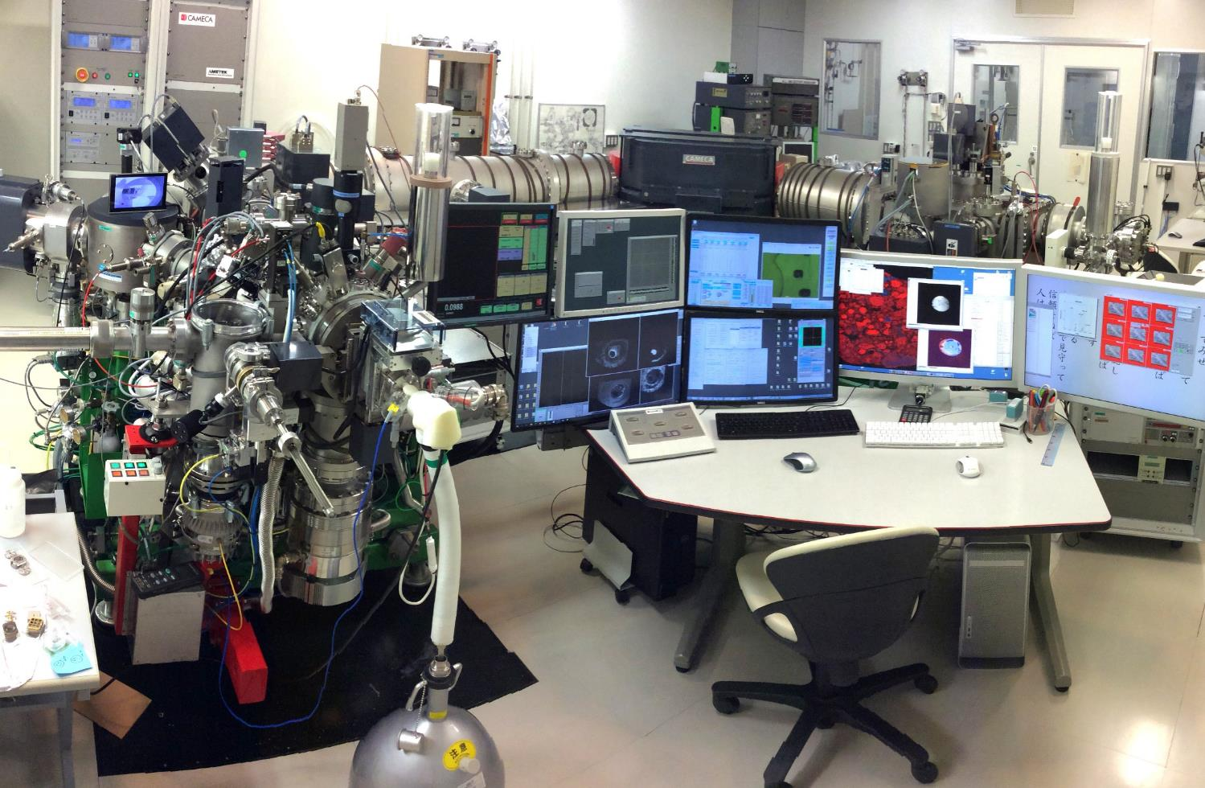
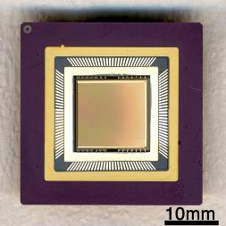
Stigmatic Isotope Imaging
Notes:
This is our machine.
Cryogenic stage and SCAPS.
At first, I will explain how to get isotope image.

Slide 7
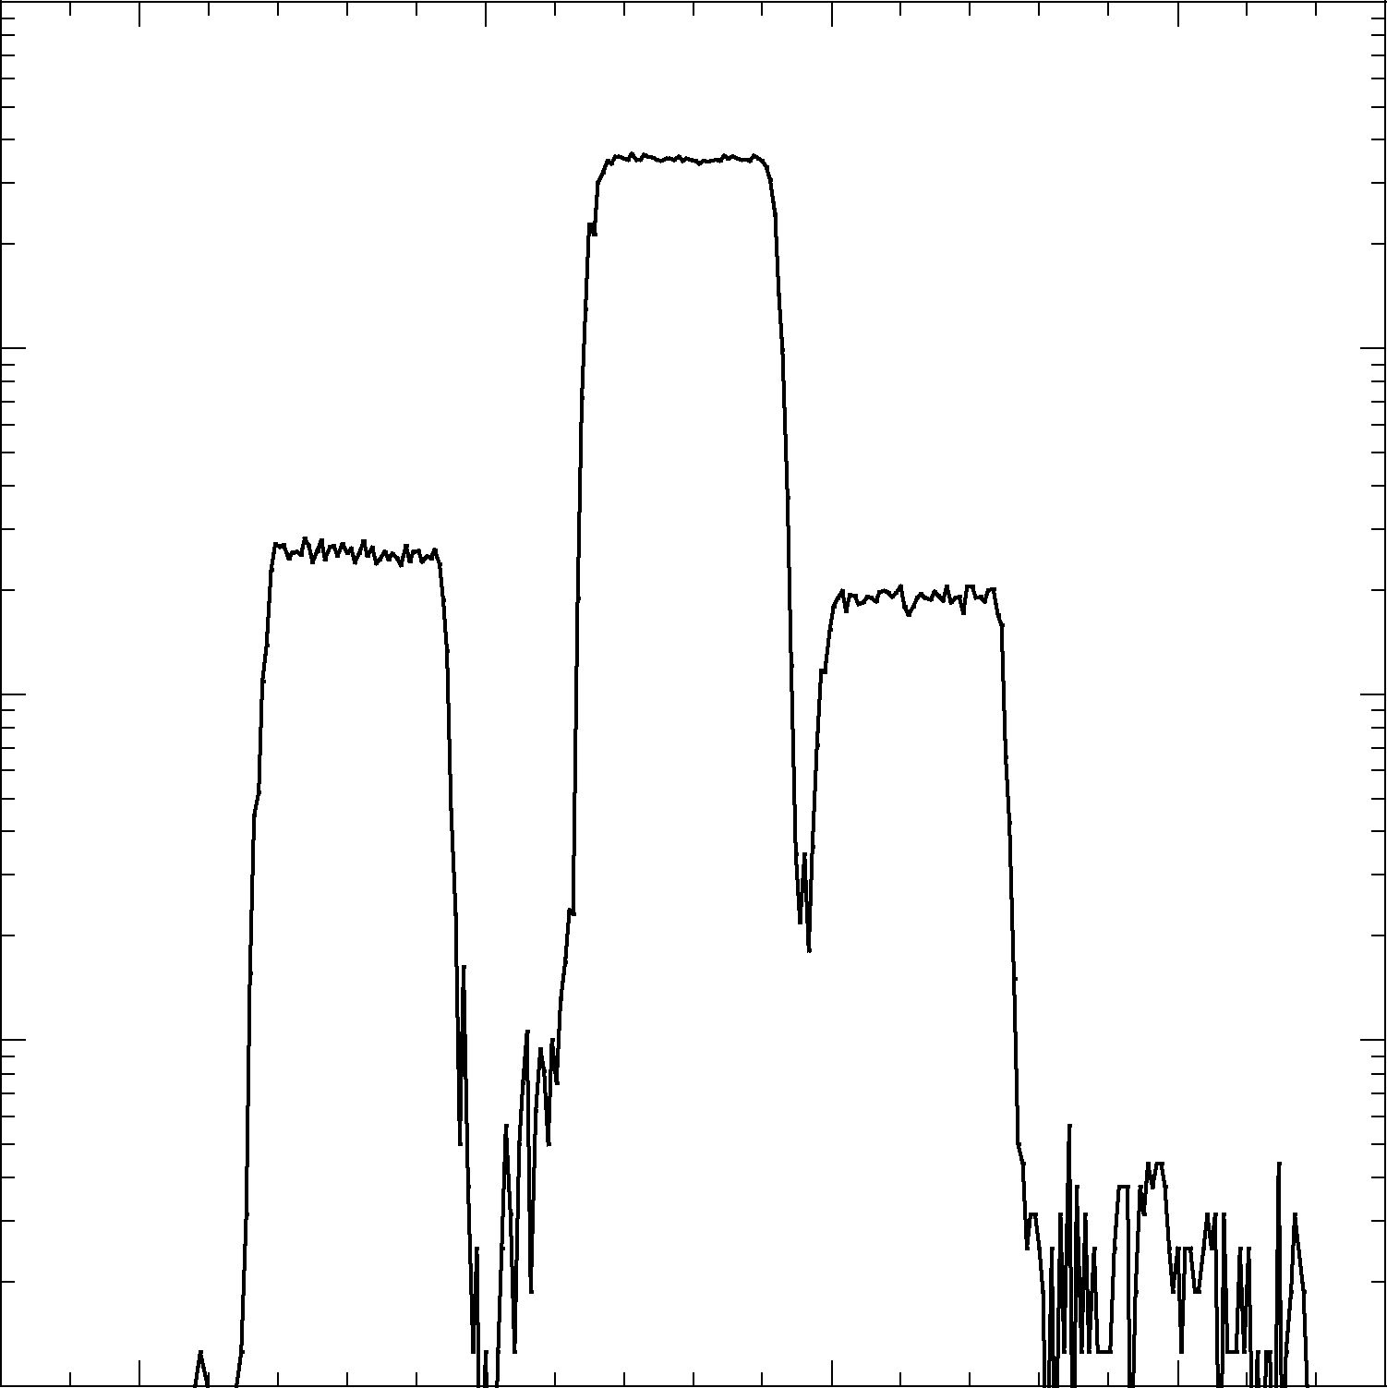
Stigmatic Isotope Imaging
Organics
¹⁰B¹⁶O
¹²C¹⁴N
¹²C¹³C¹H
Intensity
26.000
26.005
26.010
26.015
Mass
Notes:
For nitrogen, we measure CN as nitrogen signal because of the low ionization efficiency of nitrogen single atom.
This is a mass spectrum around C12N14.
In organics case, BO is a big interference for 12C14N.

Slide 8
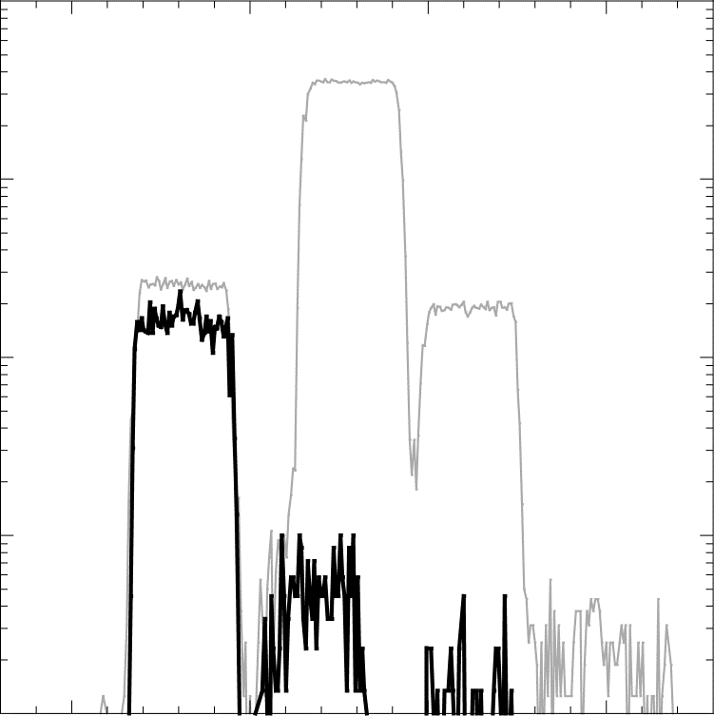
Stigmatic Isotope Imaging
Organics
Diamond
¹⁰B¹⁶O
¹²C¹⁴N
¹²C¹³C¹H
Intensity
¹³C¹³C
26.000
26.005
26.010
26.015
Mass
Notes:
In diamond case, 13C13C is a main interference requiring more than 8000 mass resolving power at least.

Slide 9
Stigmatic Isotope Imaging
Organics
Diamond
¹⁰B¹⁶O
¹²C¹⁴N
¹²C¹³C¹H
Intensity
¹³C¹³C
26.000
26.005
26.010
26.015
Mass
Notes:
If we project the mass signal on 2 dimensional ion detector,

Slide 10
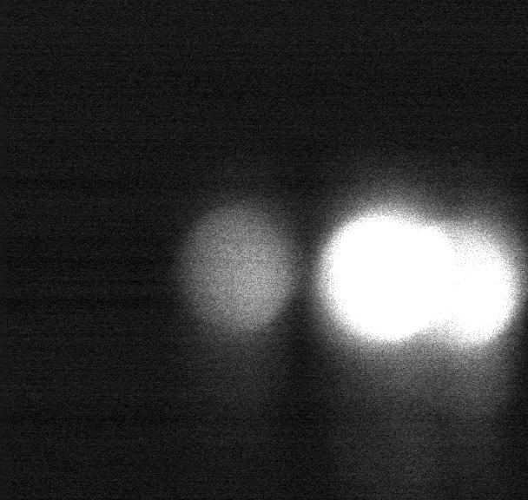
Stigmatic Isotope Imaging
Isheyevo lithic clast
Exit Slit
¹²C¹⁵N
¹¹B¹⁶O
¹³C¹⁴N
Mass
Notes:
We can see the mass image.
In the case of 12C15N on Isyeyevo lithic clast,
There is strong boron signal.
(click)
We narrow a slit to cut these interferences.

Slide 11
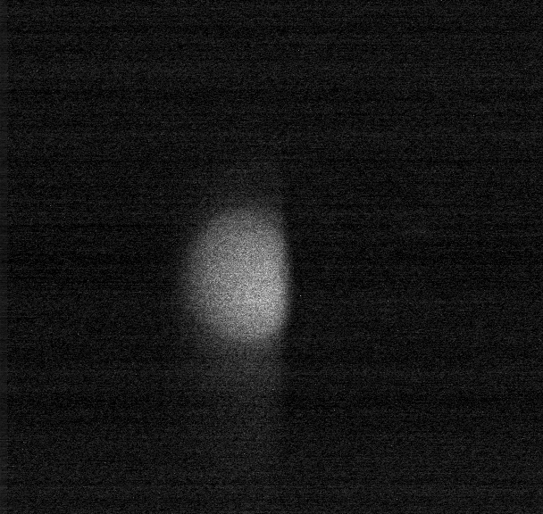
Stigmatic Isotope Imaging
Isheyevo lithic clast
Exit Slit
¹²C¹⁵N
¹¹B¹⁶O
¹³C¹⁴N
Mass
Notes:
Then, we can get signal from the target isotope only.

Slide 12
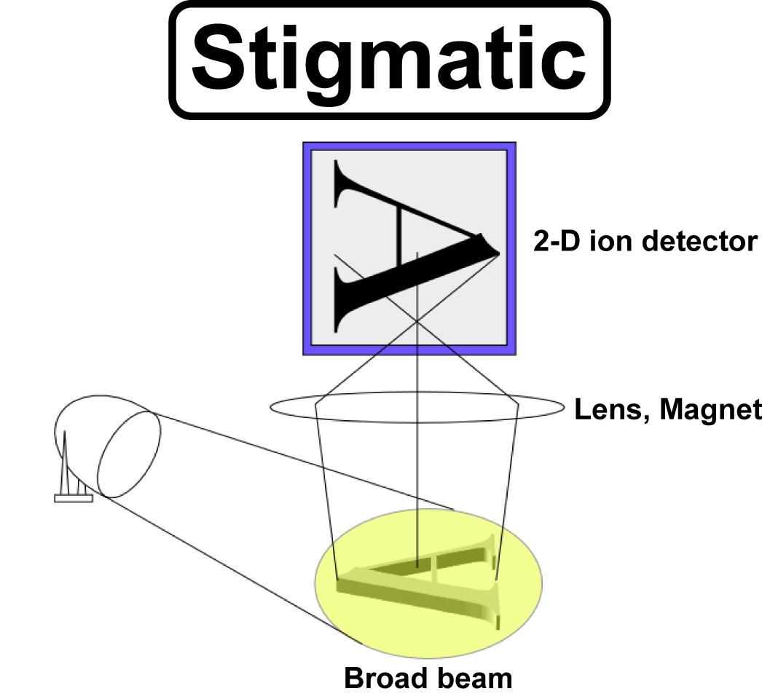
Stigmatic Isotope Imaging
Isheyevo lithic clast
Exit Slit
¹²C¹⁵N
¹¹B¹⁶O
¹³C¹⁴N
Mass
Notes:
We can use high intense beam based on the stigmatic optics for high precision and fast isotope imaging.

Slide 13
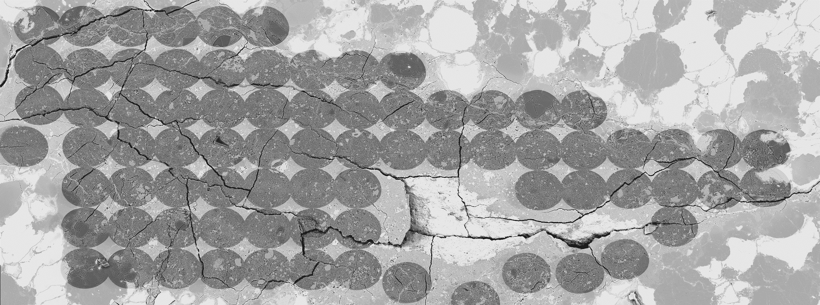
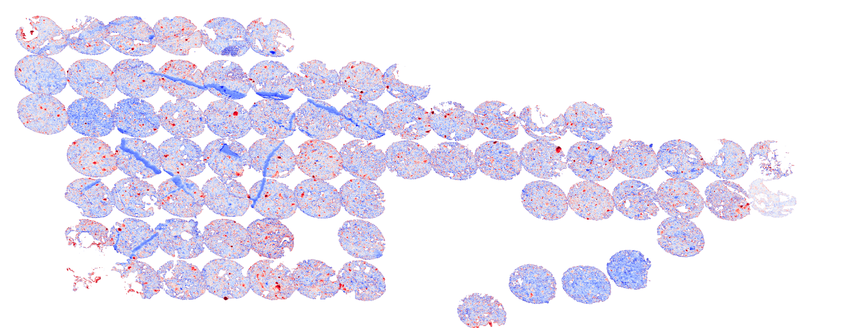
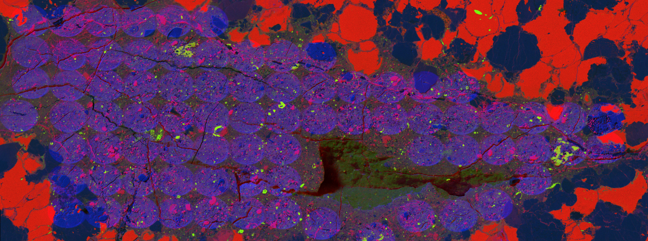
Isheyevo 2-3
500μm
-1000
2000
FeSO
δ¹⁵N
Notes:
For example, this is a BSE image taken after metsoc meeting analysis.
Scale bar is 500 micron.
Circle indicates ion beam radius about 80 micrometer.
(click)
We mainly measured lithic clast at that time.
(click)
This is d15 Nitrogen mosaic map.
Color bar is -1000 to 2000.
All material in this region has higher d15N relative to earth contamination.
Several interesting stuff were found.

Slide 14
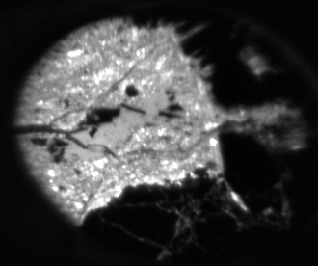
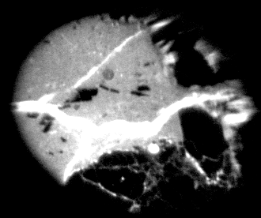
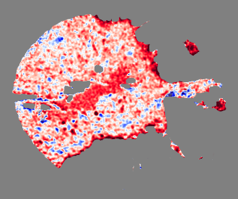
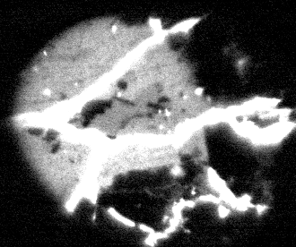
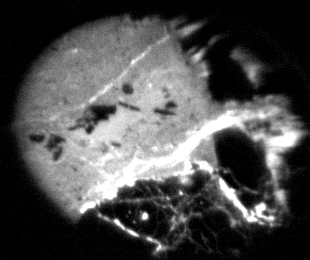
Isheyevo 2-3
¹²C¹⁴N
¹⁶OH
δ¹⁵N
+200 ‰
¹⁹F
-1000
³⁵Cl
FeSO
δ¹⁵N
5000
+400 ‰
Notes:
This is one of them.
Nitrogen and Hydrogen, Relatively low Fluorine, high Chlorine.
(click)
This is d15N image.
This material has high and homogeneous d15N relative to surroundings.

Slide 15
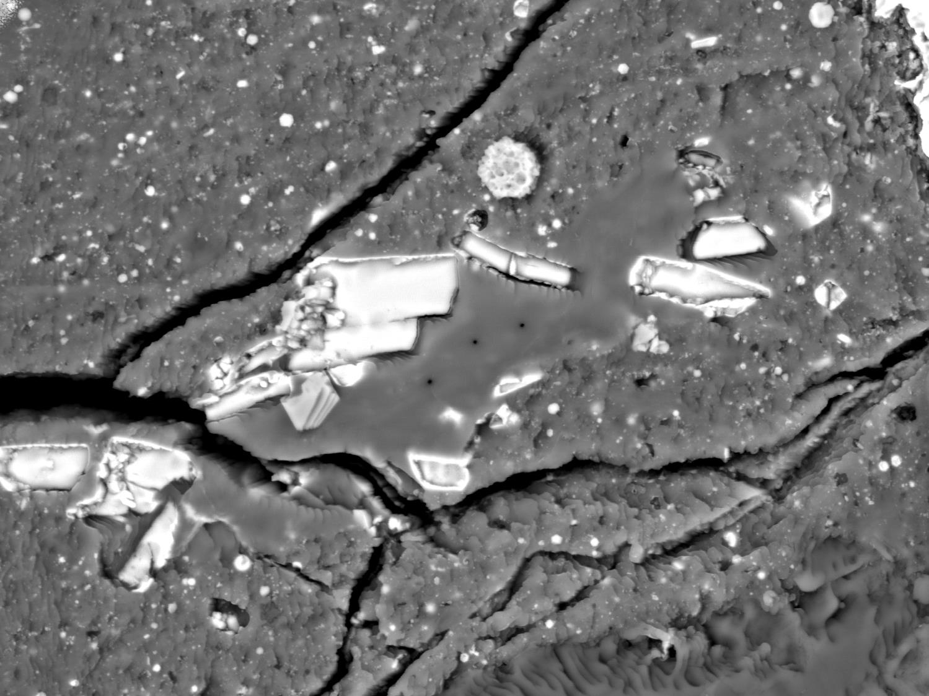
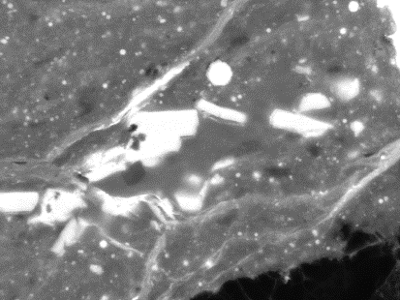
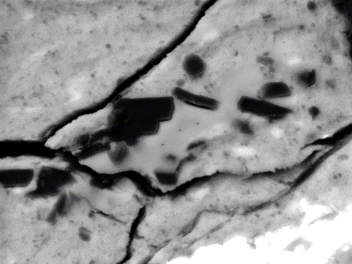
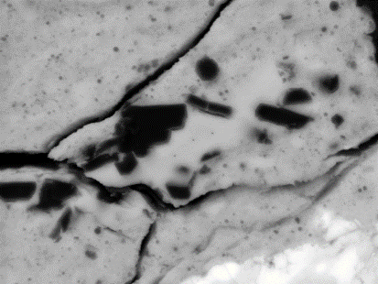
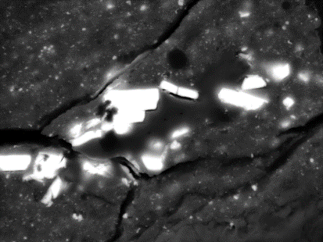
Fe
Mg
Si
S
Sakamoto@JpGU2020
10μm
Notes:
This is BSE image of the material.
Scale bar is 10 micron.
This material is very weak to electron beam.
(click)
The major chemical composition is similar to surroundings.
Attached are FeS.
(click)
I will present the nitrogen study at JpGU AGU joint meeting this year.
Please come back to Japan again.

Slide 16
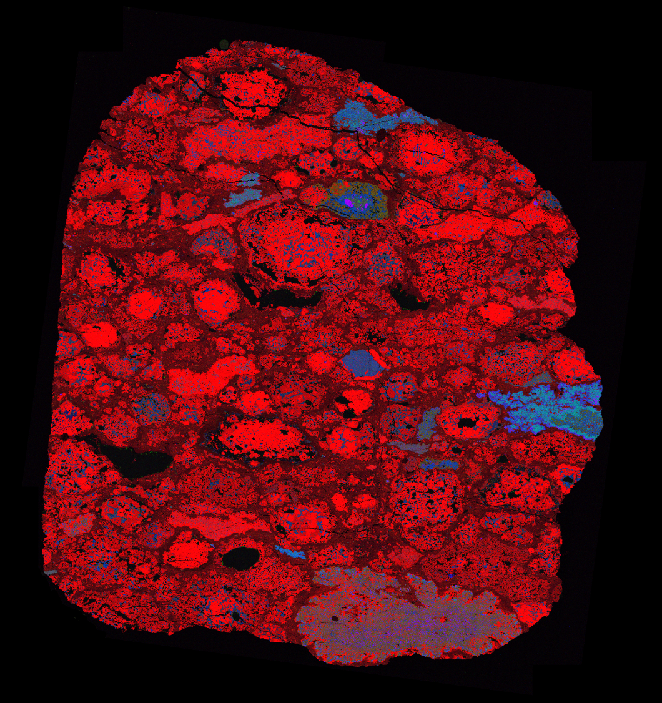
TIL 07007
Notes:
Let’s move on to main topic.
This is RGB map of TIL 07007 obtained by Korean Polar Research Institute.
(click)
If we look this region,

Slide 17
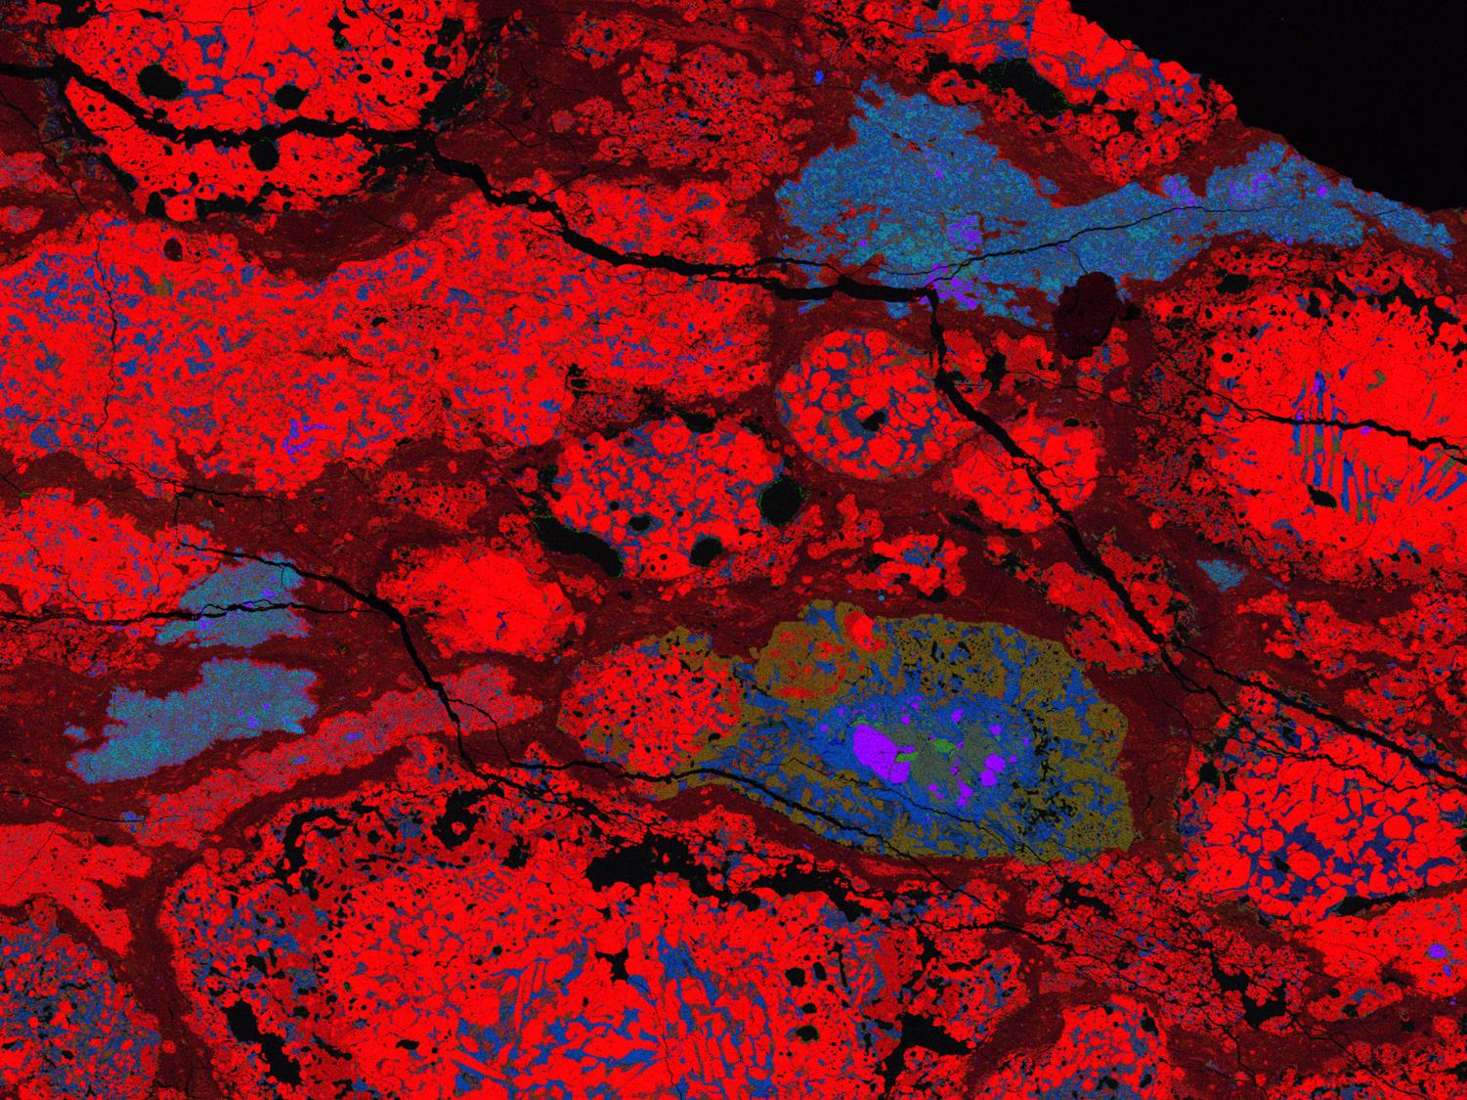
CHD
MgCaAl
CHD
CHD
CAI
AOA
CHD
CHD
CHD
CHD
AOA
CHD
CHD
CAI
CHD
CAI
CHD
AOA
CHD
AOA
CHD
CHD
AOA
CHD
CHD
Notes:
We can see many objects.
(click)
We normally classify to CAI, AOA or chondrule.
Most of CAIs and AOAs show O16-rich composition, chondrule show O16-poor.
Therefore, If we map an intermediate object,
(click)
We may trace the material interaction or evolution occurred in the early solar nebula using oxygen isotope.

Slide 18
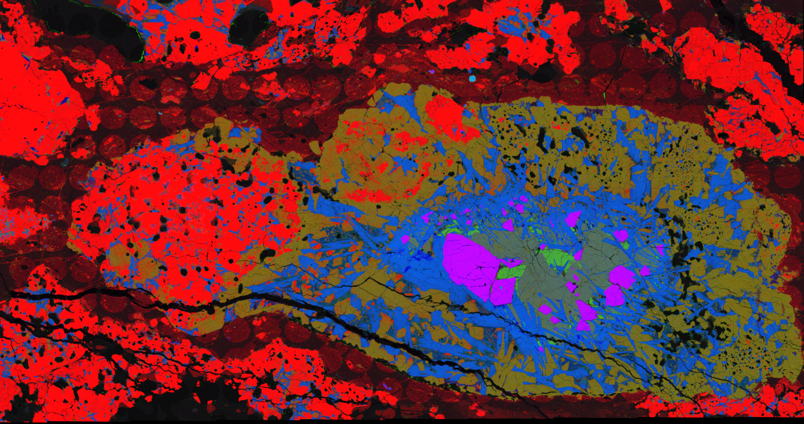
MgCaAl
CHD
CAI
Notes:
This object is composed of Mg-rich region and Ca-Al-rich region.
(click)
I call this object as a compound object, and here is chondrule part and here is CAI part in this talk.

Slide 19
MgCaAl
CHD
CAI
Notes:
We mapped this compound object divided 13 by 26 areas using 80 micrometer diameter beam with 100 micrometer step.

Slide 20
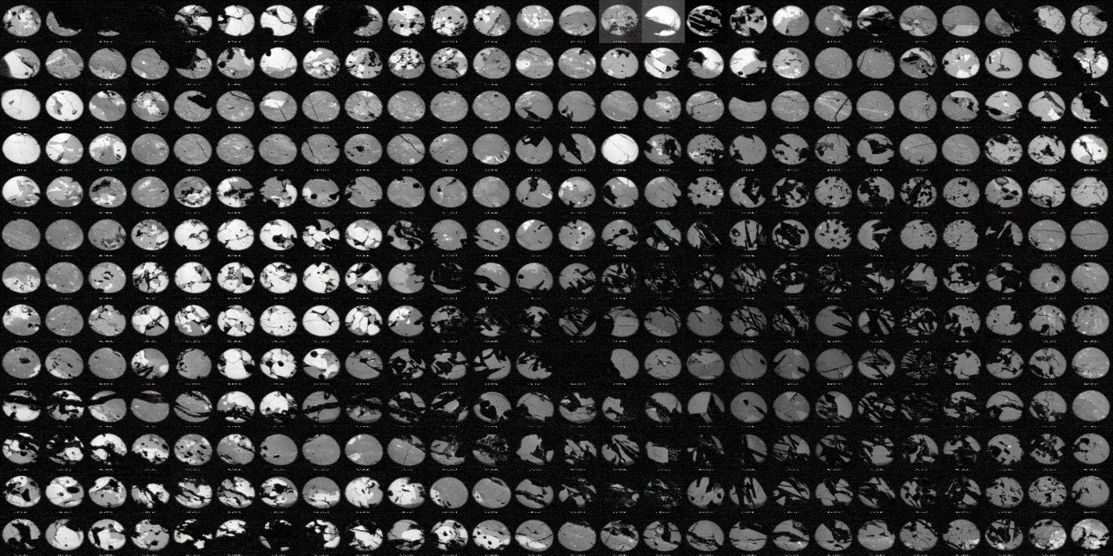
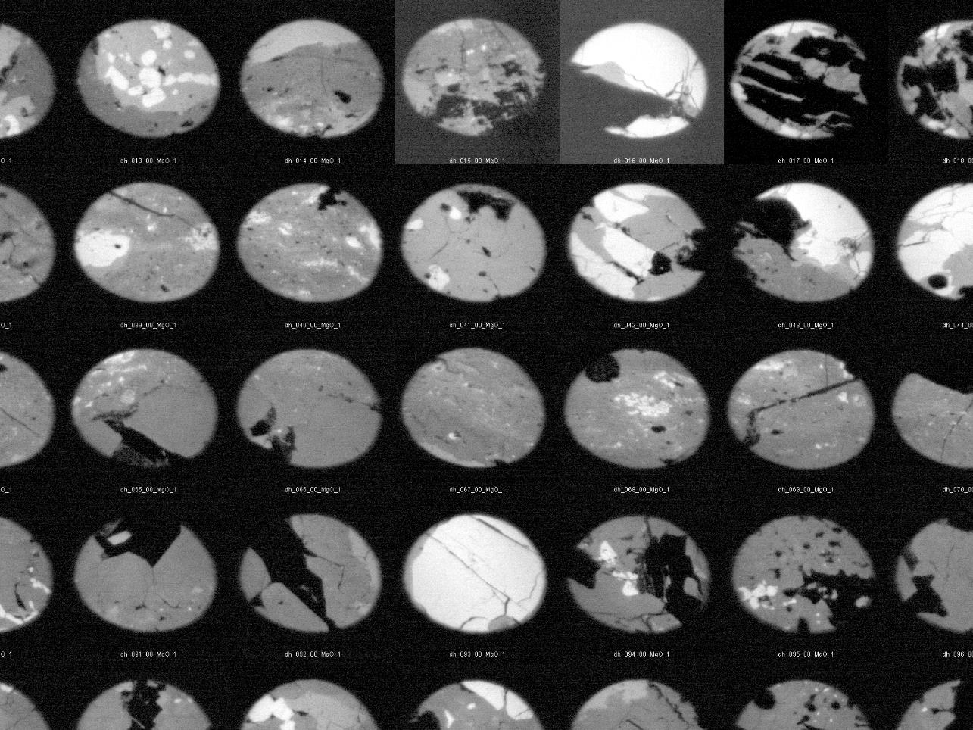
²⁴Mg¹⁶O
LN2 depleted
Refill
Notes:
This is MgO map.
Chondrule part is rich in Mg, CAI part is poor.
You may find strange area
(click) here. This is because
(click) Analysis start from here to this direction
(click) at this point, liquid nitrogen for ion imager depleted, may be I forgot, then output signal of imager increase
(click) after refill liquid nitrogen
(click) the signal become normal.

Slide 21
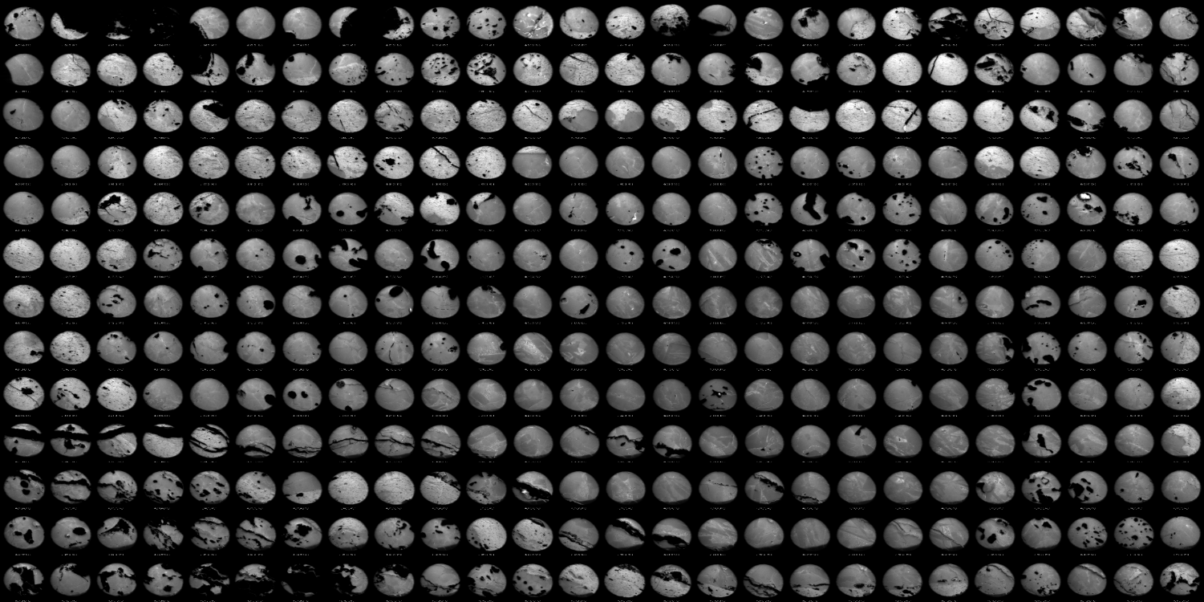
¹⁶O
Notes:
This is O16.
The intensity of O16 is high enough to ignore the temperature change.

Slide 22
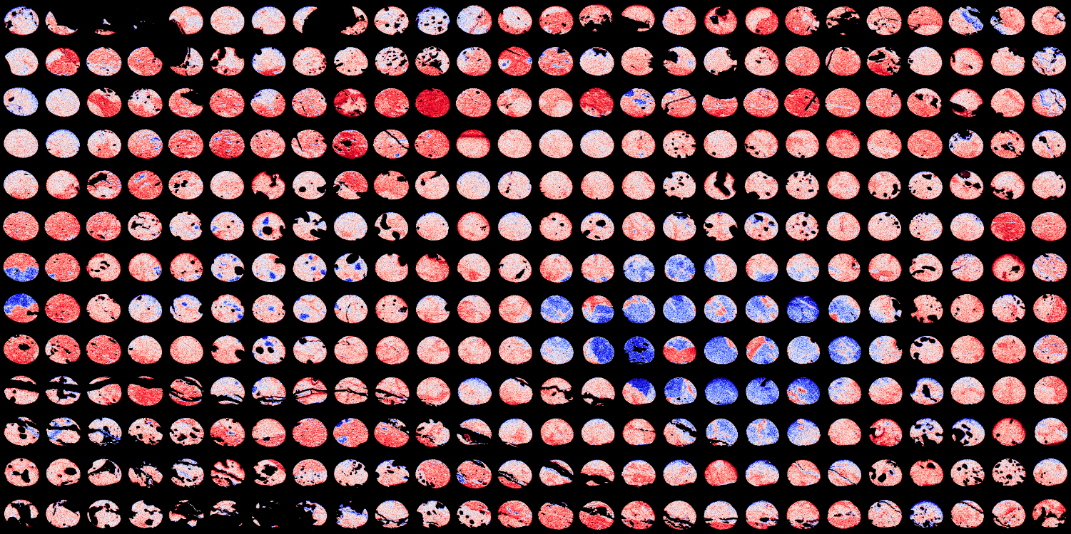
δ¹⁸O
¹⁶O-rich
¹⁶O-poor
-80
δ¹⁸O
40
Notes:
This is d18O map.
Blue color indicates 16O-rich, red color indicates 16O-poor.
At first, let see........
(click)
here.

Slide 23
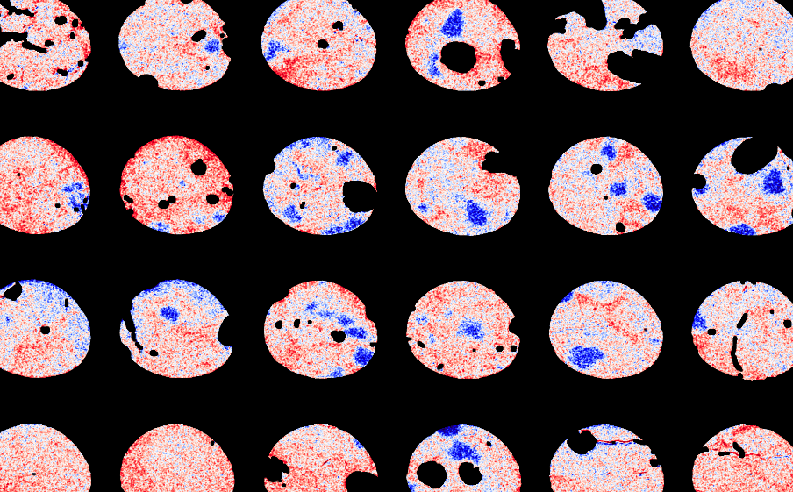
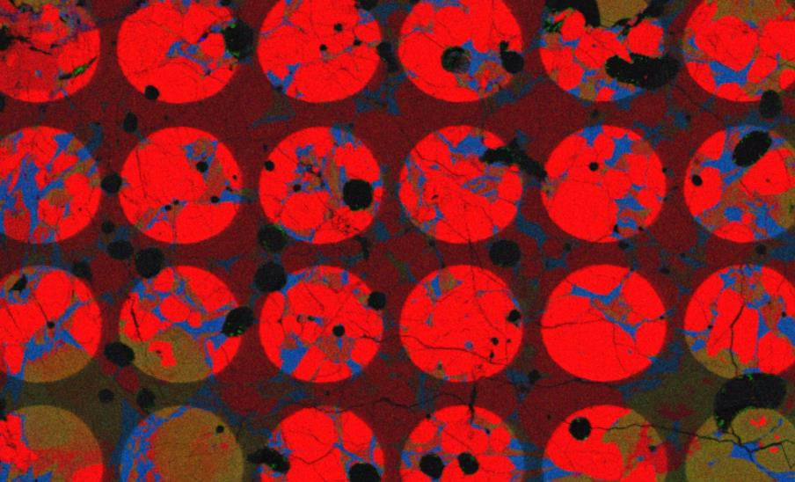
Chondrule
¹⁶O-rich
¹⁶O-poor
-80
δ¹⁸O
40
Notes:
Here is chondrule part.
(click)
There are many 16O-rich portion.

Slide 24
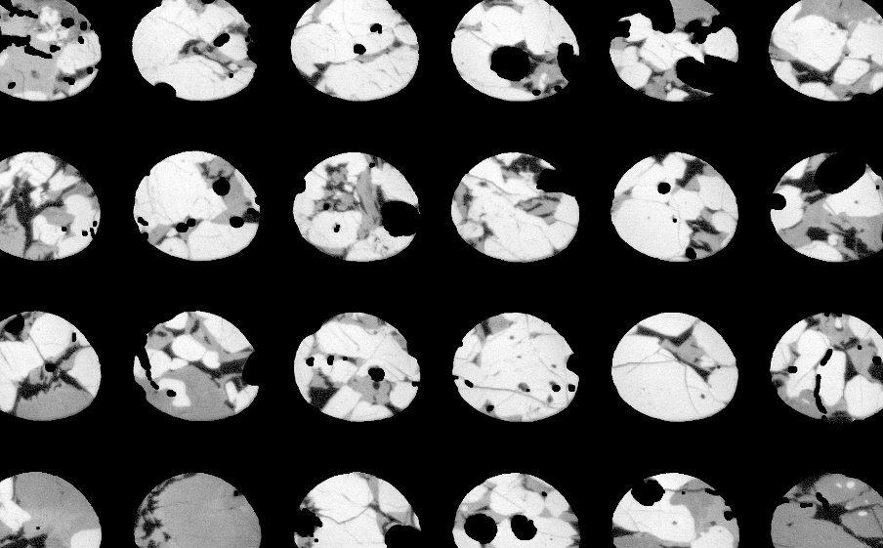
Chondrule
Relict Olivine
¹⁶O-rich
¹⁶O-poor
-80
δ¹⁸O
40
Notes:
When d18O and Mg image are displayed alternately
we can recognize the 16O-rich portions exist in the Mg-rich, Olivine crystals.

Slide 25
CAI
Notes:
In CAI part,

Slide 26
CAI
Notes:
Looks more blue, 16O-rich especially for this crystal and we can see Mg-poor needle like crystals.

Slide 27
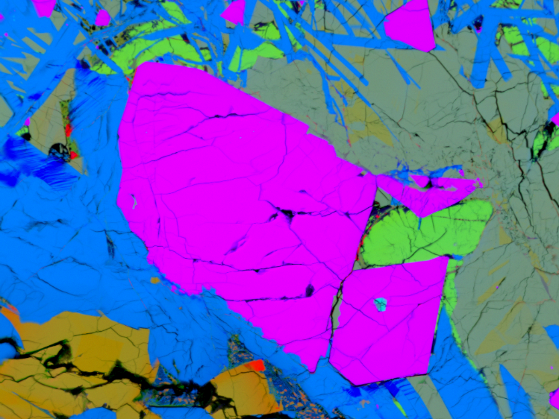
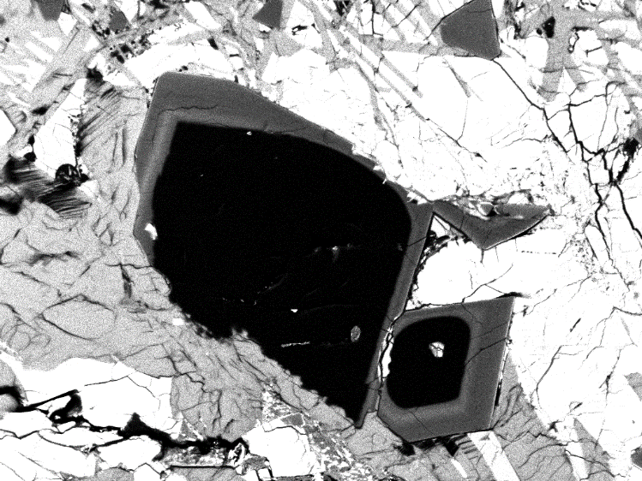
CAI
Overgrowth
Cr
Δ¹⁷O = -23‰
Relict Spinel
Δ¹⁷O = -18‰
Notes:
The most 16O-rich part is spinel, outer part is slightly 16O-poor.
(click)
We also confirmed this difference by spot analysis.
(clickm repeat)
If we look at Chromium obtained by EDS, this spinel composed of Cr-poor core and Cr-rich relict.

Slide 28
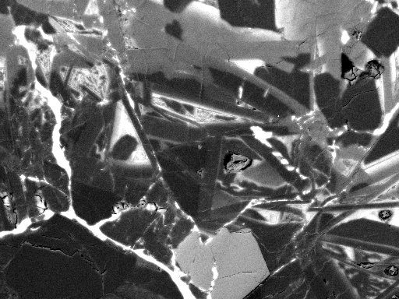
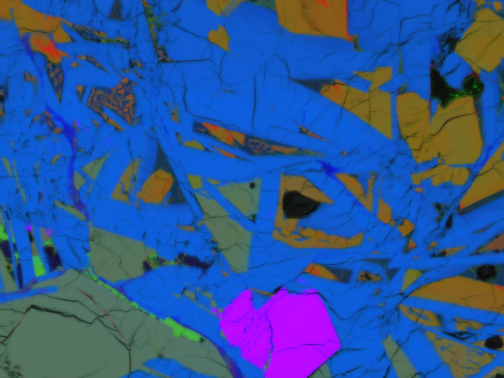
CAI
Relict Anorthite
Na
Notes:
Finally, let’s see needle like crystal
(click) Anorthite.
(click, repeat)
There are 2 types of Anorthite, Na-poor and Na-rich.
(click)
Na-poor Anorthite is 16O-rich, Na-rich Anorthite is relatively 16O-poor.

Slide 29
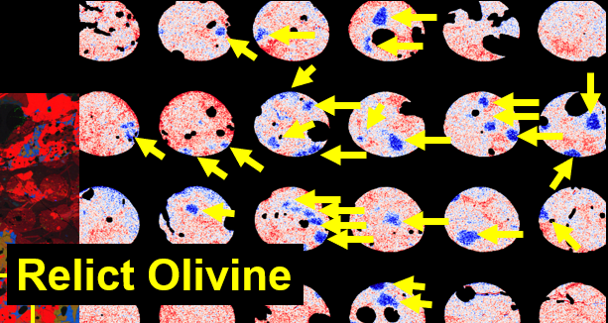
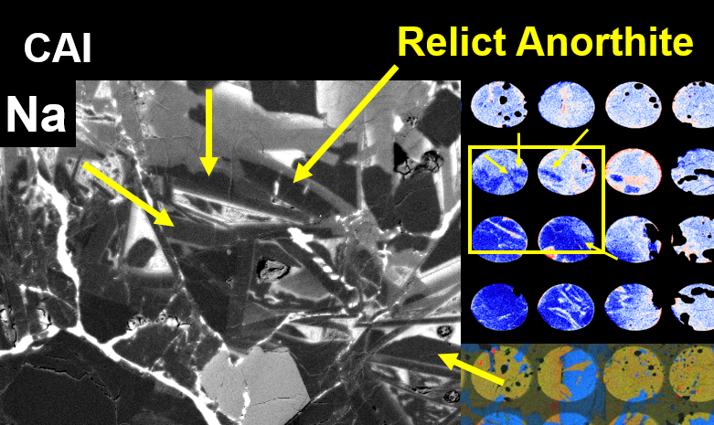
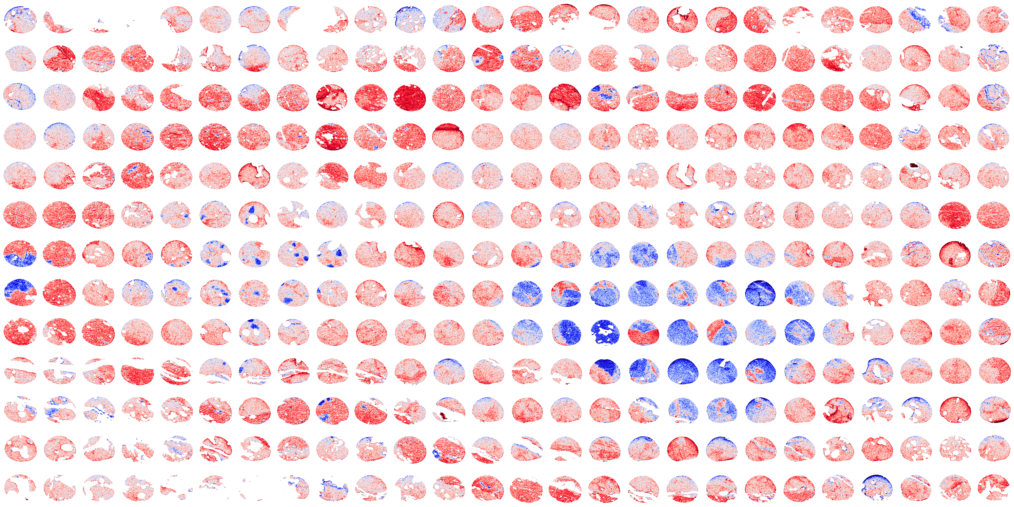
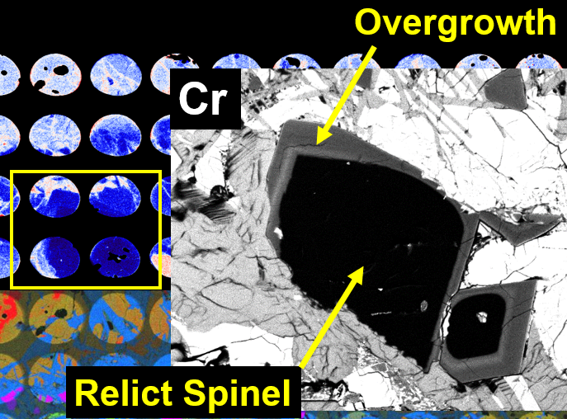
Notes:
As we have seen, large scale isotope mosaic map
(click)
clearly help us
(click)
to understand complex history at a glance.
I stop here because of too much information.
But,

Slide 30
TIL 07007
✓Crystal map
✓Chemical map
Isotope map
Notes:
In this study, we could reveal the oxygen isotope distributions
(click) just only this region.
(click) Optical or Electron probe can give us entire crystal and chemical information.
(click)
Now, I am working on the last piece to start my meteorite study.

